Slide 1
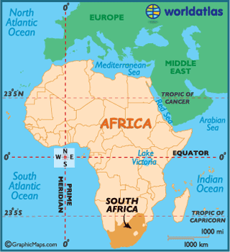
South Africa

Slide 2
Geography
Rain forests
Deserts
Deep valleys
High mountains
Beautiful beaches

Slide 3
High and Low Lands
2/3rds of S. Africa is high land.
Very few people live on it
Too dry and hot
Has wide, flat areas usually covered in grass and low bushes-called velds.
Has low, flat plains and deserts

Slide 4
Different Landforms
Kalahari Desert-large desert that spreads over 3 countries in Africa
Coast in the town of Noordoek-one of S. Africa’s three capital cities
Vineyards-soil and climate are good for growing grapes
Drakensberg Mountains-highest mountains in S. Africa
Orange River-S. Africa’s longest river

Slide 5
Natural Wonders
Game reserves-land set aside for animals
Animals are protected from hunters
Safaris-a trip to an African game reserves
More than 20,000 plant species in S. Africa

Slide 6
Rich Natural Resources
Have some of the largest and most important mineral resources in the world
Mineral-a resource found in nature that is not an animal or plant
Ex. Diamonds
Gold
Copper
silver

Slide 7
The 1st South Africans
Home to our oldest human ancestors
Date back about 50,000 years

Slide 8
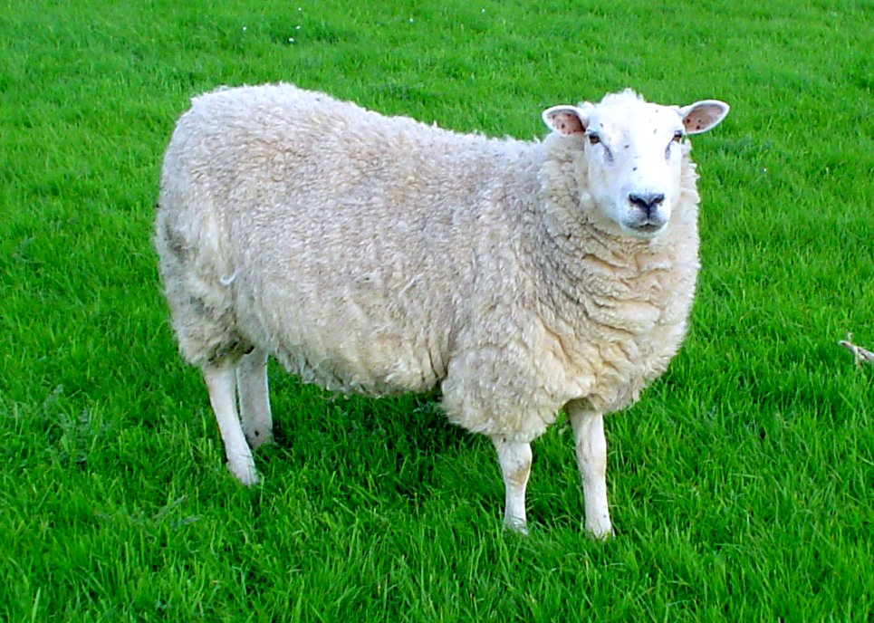
San and Khoikhoi
San people came about 20,000 yrs ago.
Traveled, hunted animals and gathered food to eat
Khoikhoi-live off the land
Farmed and raised animals
Ex. Sheep and cattle

Slide 9
The Europeans
1652-Dutch settled in S. Africa
Known as Boers-a dutch word meaning “farmer”
British and Germans and Zulu eventually take over S. Africa-Britain wins and gains control

Slide 10
A Divided South Africa
White people ruled S. Africa
Apartheid-the black people and white people had to live apart
White people had to live separately from black people
Blacks had to live in the poorest part of the land called homelands

Slide 11
Black people fought hard against the white people
Nelson Mandela helped lead the fight to end the apartheid
Finally fell apart in the early 1990s

Slide 12
Life after Apartheid
April 1994-the first time everyone over the age of 18 could vote
Nelson Mandela was elected as the first president of South Africa

Slide 13
Governing South Africa A New Plan
A new constitution was written
Constitution-a written form of government

Slide 14
Bill of Rights
Similar to the US Bill of Rights
Offers:
Health care
Education
Freedom
A healthy environment-the air, water, land, and all living things

Slide 15
3 Branches of Government
Legislature Branch-called Parliament
Make the laws
Made up of the National Council of Provinces & the National Assembly

Slide 16
Executive Branch-headed by the president
Judicial Branch-made up of many courts
Tell if someone has broken a law
Top court-Supreme Court of Appeals
Highest court-called the Constitutional Court

Slide 17
3 Capitals
South Africa has 3 capitals
Each capital is home to a branch of the government
Pretoria-executive
Cape Town-legislative
Bloemfontein-judicial

Slide 18
South Africa at Work :Selling to other Countries
Creates over 25% of Africa’s wealth
Mining
More than half of the money comes from mining

Slide 19
Working in Factories
Many people work in factories
Make trains, cars, ships, computers, clothing, processed food, steel, iron, metals

Slide 20
New Chances
Under the apartheid, many black South Africans could not go to school
Agriculture-the business of growing crops and raising animals.
Cash crops-farmers who raise their crops for money
Livestock-animals raised on farms and ranches

Slide 21
Two Exciting Cities
Johannesburg is South Africa’s largest city
More than 3 million people live there
Durban-South Africa’s second-largest city
Cape Town-where Nelson Mandela gave his first speech

Slide 22
Fun in South Africa
South Africans love playing rugby and cricket
Rugby- a sport like football
Cricket-a sport like baseball
Play soccer
Tournament-a series of games

