Slide 1
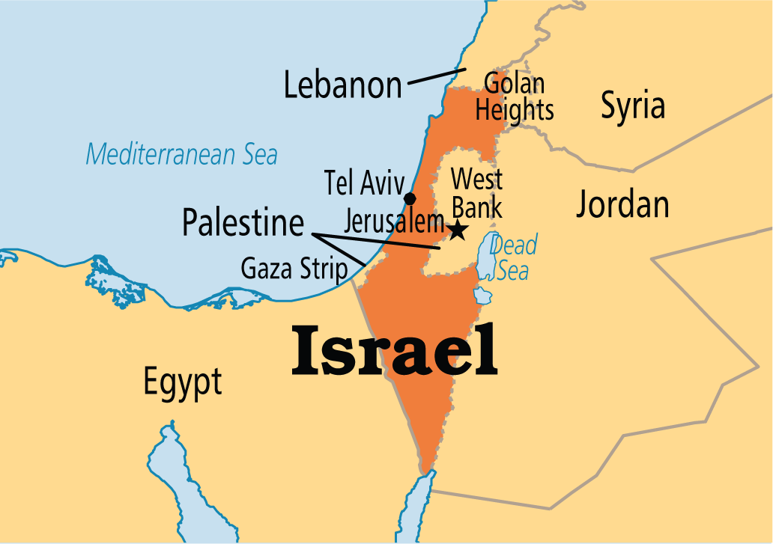

Slide 2
Land is sacred to the Jewish people for thousands of yrs.
Parliamentary government
Language-Hebrew- official
Independence-May 14, 1948
Official name: State of Israel
Major river: Jordan

Slide 3
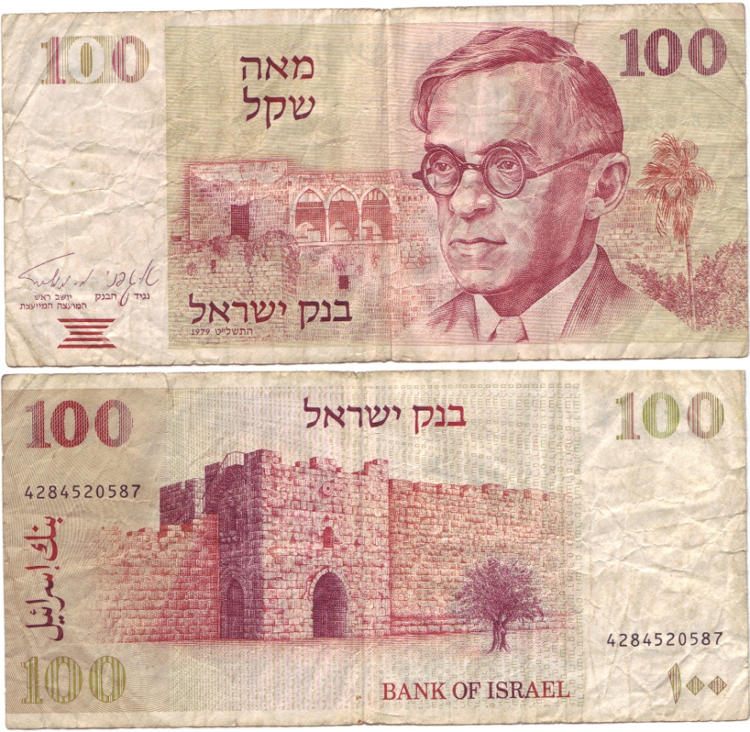
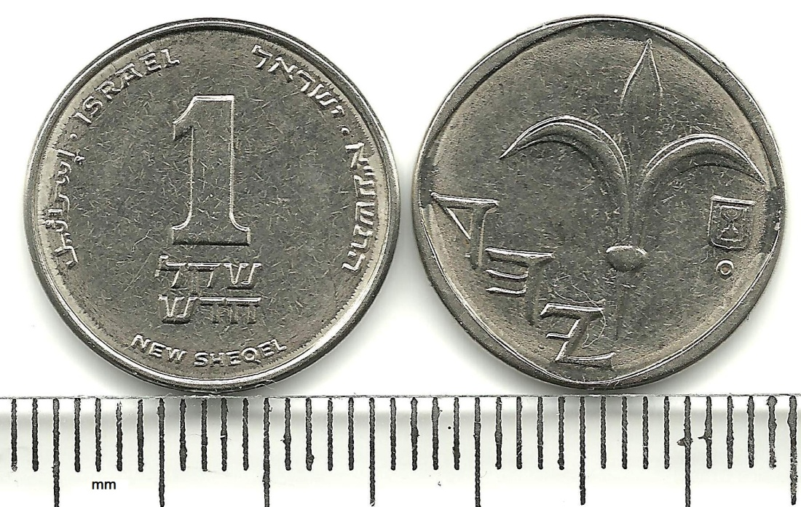
Monetary unit: shekel

Slide 4
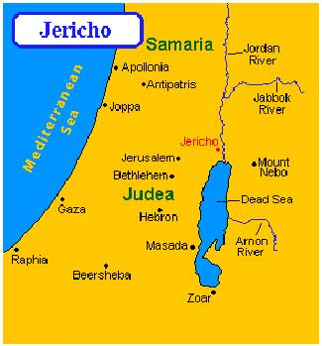
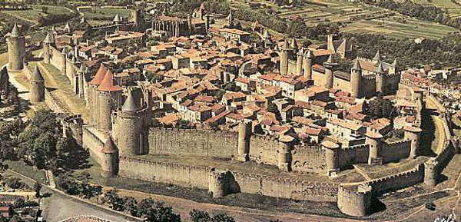
Settled in 9500BC-Arab city of Jericho
One of the oldest human settlement

Slide 6
People farmed and kept animals
Many people have fought and ruled Israel (ex Egyptians, Persians, Greeks, ect..)

Slide 7
Jerusalem- considered a holy city by Muslims, Jews, and Christians
The location of all 3 religions
Each religion has fought over it
Jews believe the Messiah will one day appear here
Muslims believe that Muhammad ascended to heaven from here
Christians believe this is where Jesus Christ rose from the dead

Slide 8
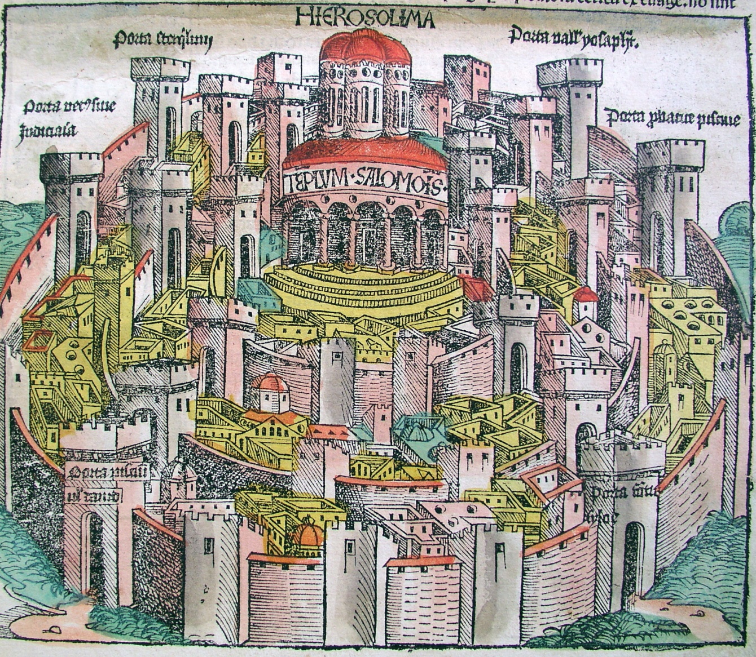

Slide 9
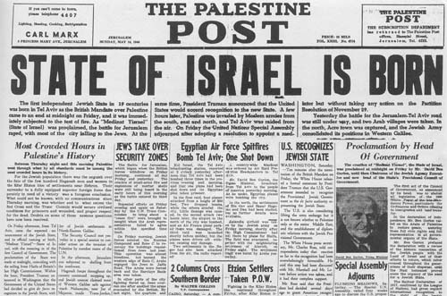
The State of Israel was created after Israel fought 6 wars with its Arab neighbors

Slide 10
Culture and People
About 2/3 of the population was born here
People are called Israelis
Come from over 100 diff. countries
About 81% Jewish
About 20%-follow about 600 rules from their religion

Slide 11
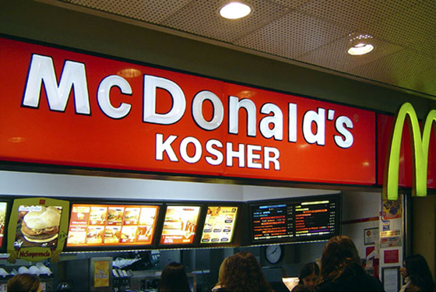
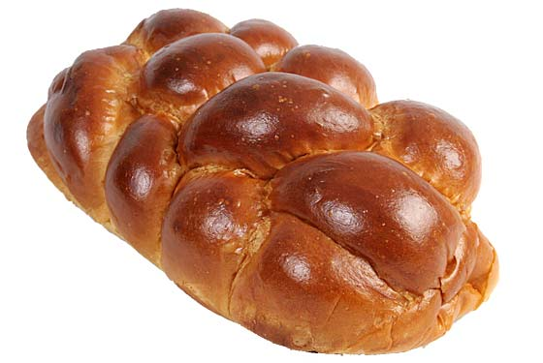
Some people eat kosher food
No pork
No shellfish
Ex. Pepperoni and cheese pizza & No mixing of meat and dairy products cheeseburgers are not kosher

Slide 12
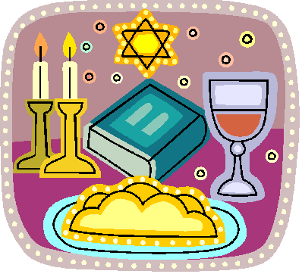
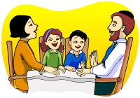
Jewish people take off Shabbat, or a day of rest
Begins Friday at sundown-Saturday evening
Store close-no work

Slide 13
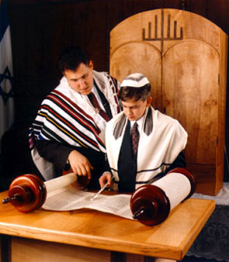
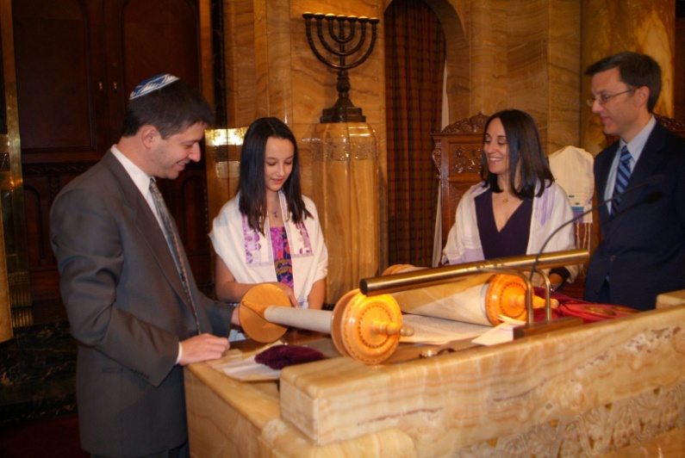
Boys reach 13 yrs old-Bar Mitzvah
Girls-12 yrs old-have a Bat Mitzvah
allowed to make their own rel. decisions

Slide 14
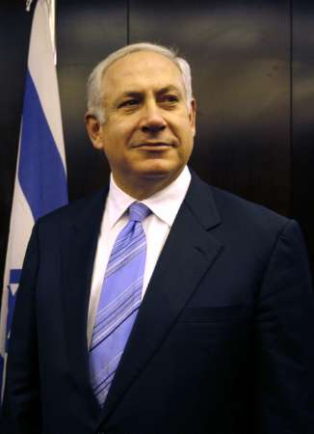
Government
Only fully democratic country in the Middle East
Elections are held for seats in the Knesset or parliament every 4 yrs

Slide 15
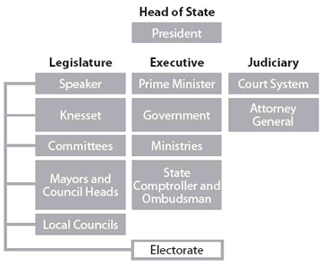

Slide 16
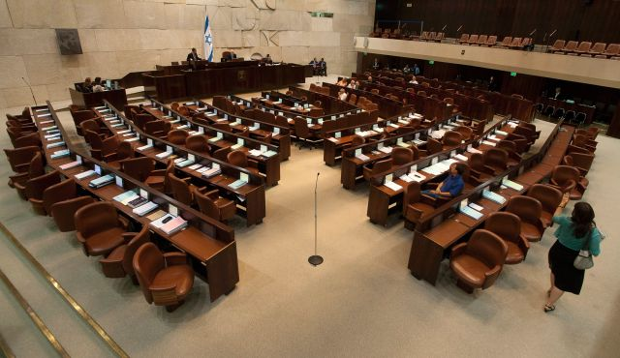
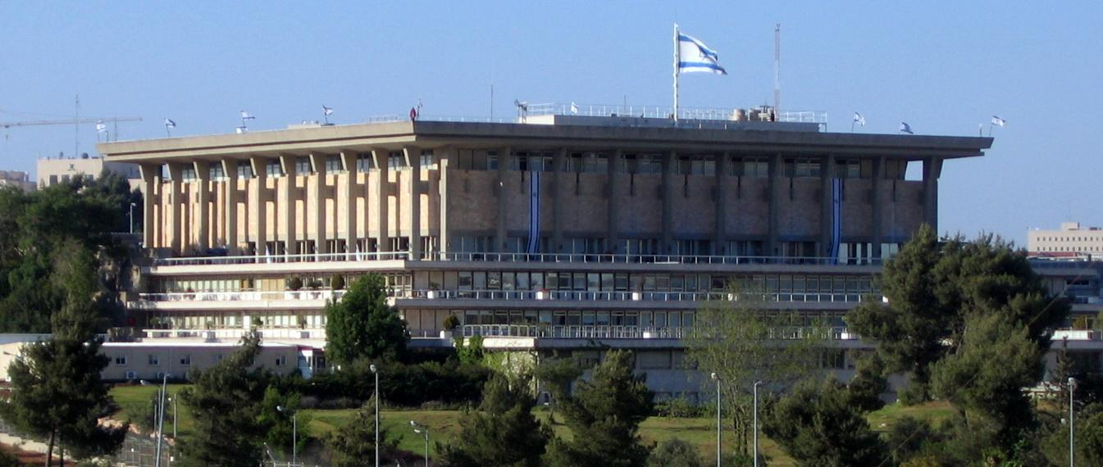
No one party has control so they have to work together
The leader of the lgest party becomes prime minister
He or she appoints a cabinet of ministers which runs the country
The 120 members of the Knesset elect a president who is the head of state

Slide 17
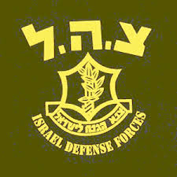
Peace does not come often
Most Jewish Israeli men & women join the Israeli Defense Forces

Slide 18
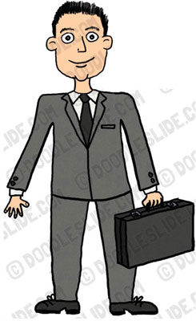
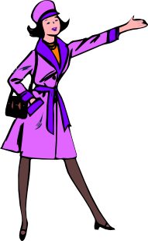
Men serve for 3 years
Women server for 2 yrs

