Slide 1
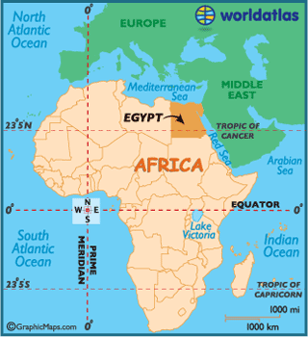
Egypt

Slide 2
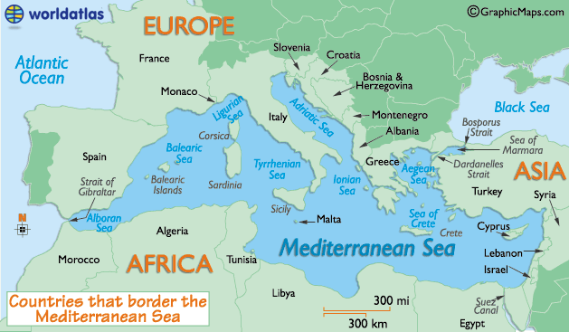
In the continent of Africa
Northern eastern edge of Africa
Mediterranean Sea lies to the north
Red Sea lies to the east

Slide 3
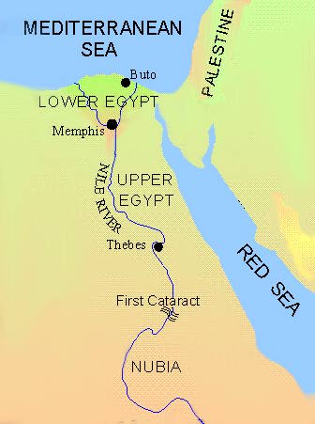
1st settlers arrived in the Nile Valley-7500BCE
BCE- “Before
the Common Era”

Slide 4
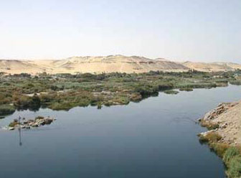
climate- wet and valley-green
Settlers ate wild plants and animals they hunted
Climate became drier-area turned to a desert-people moved to the Nile River

Slide 5
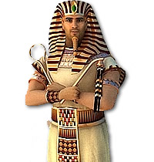
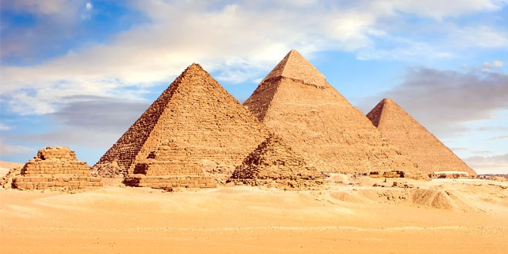
1st Egyptian Kings increased trade and spread food throughout Egypt

Slide 6
Hierophlyphs- a language of symbols

Slide 7
Passed on their knowledge by writing on tomb walls and special paper-papyrus
King Narmer-1st Egyptian pharaoh to rule over Upper and Lower Egypt

Slide 8
Pharaoh – “Great House”
A king of ancient Egypt
Began the era of dynasties
Dynasty-over many years the kings and queens of a country are from the same family

Slide 9
1 st pyramid-The Step Pyramid
Built from Sandstone

Slide 10
Pyramid Texts- magical spells were discovered written on the walls of pyramids
Thought to protect the dead from danger

Slide 11
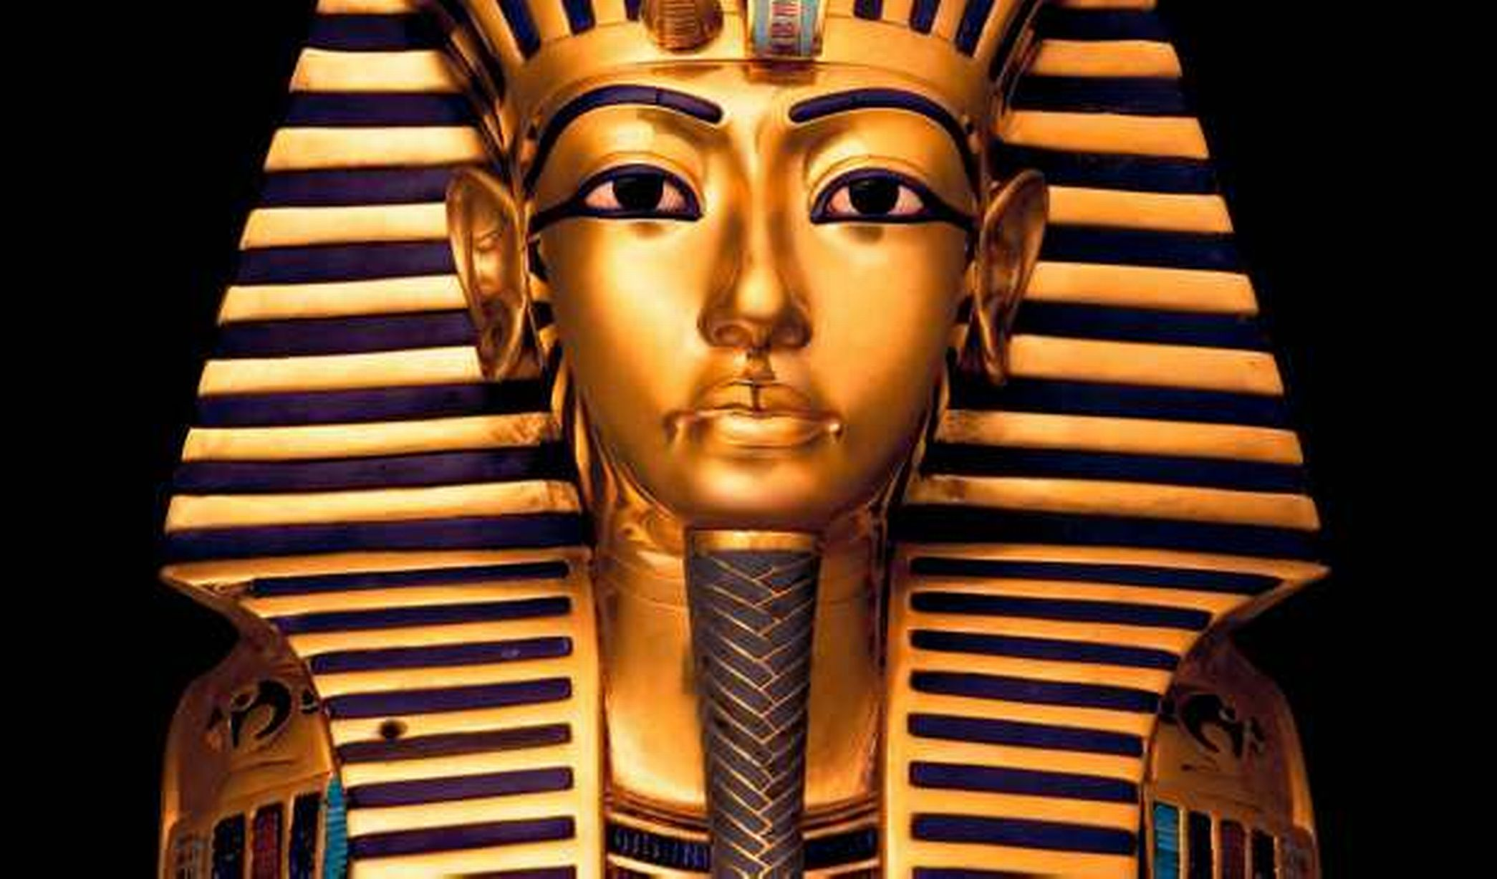
Tutankhamen-famous pharaoh
Only 19 when he died

Slide 12
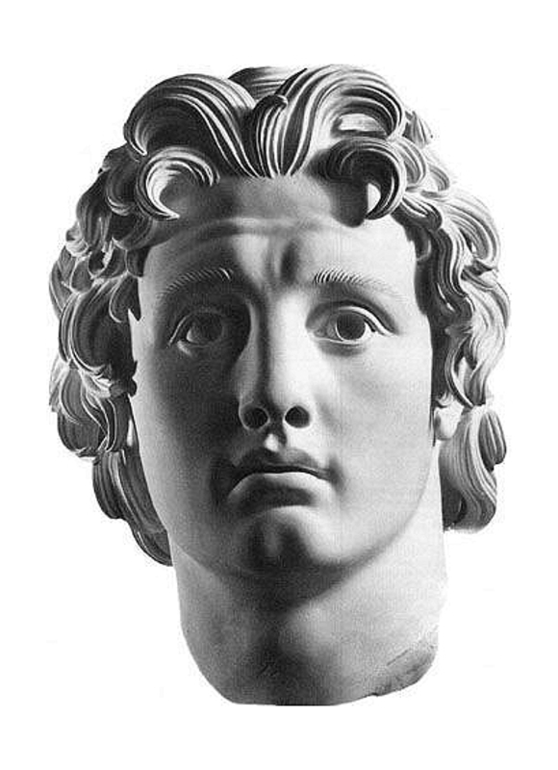
332 BCE-Alexander the Great conquered Egypt
Pharaoh
god by the Egyptians
Founded the city Alexandria-capital

Slide 13
Rosetta Stone
Slab of stone that provided the key to deciphering Egyptian hieroglyphics
Displays 3 different kinds of writing
Greek
Egyptian
Hieroglyphics-a cursive form of Egyptian

Slide 14
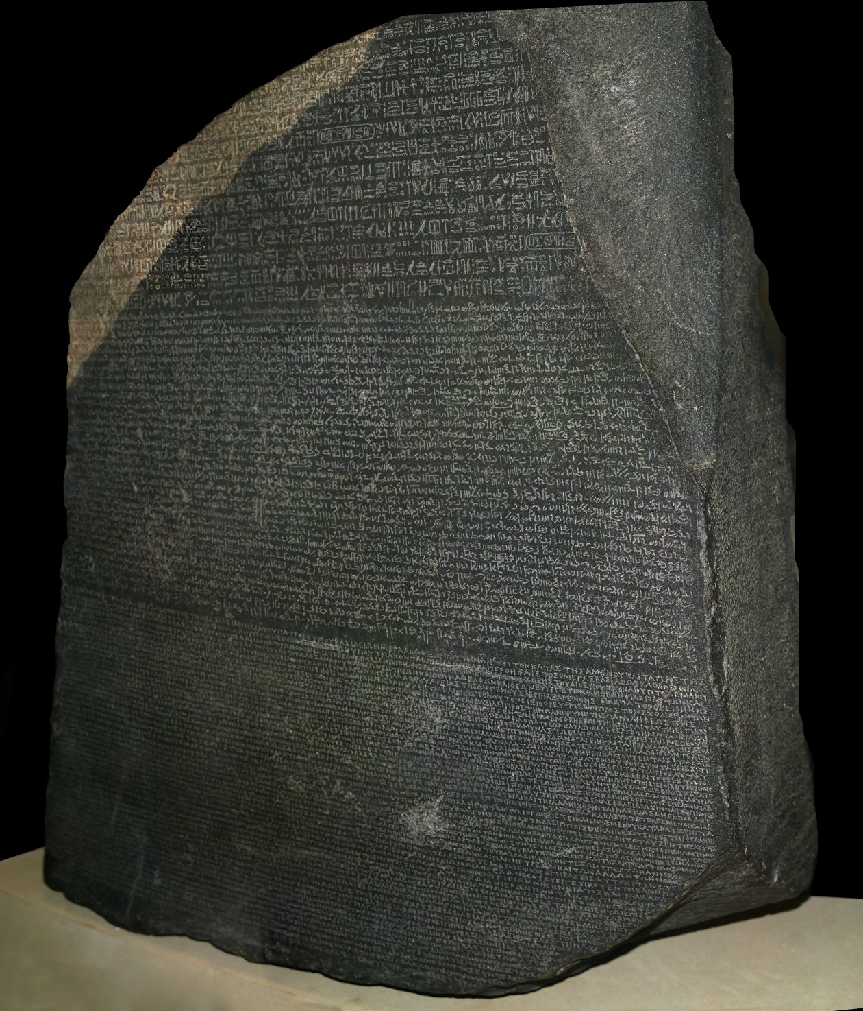

Slide 15
