Slide 1
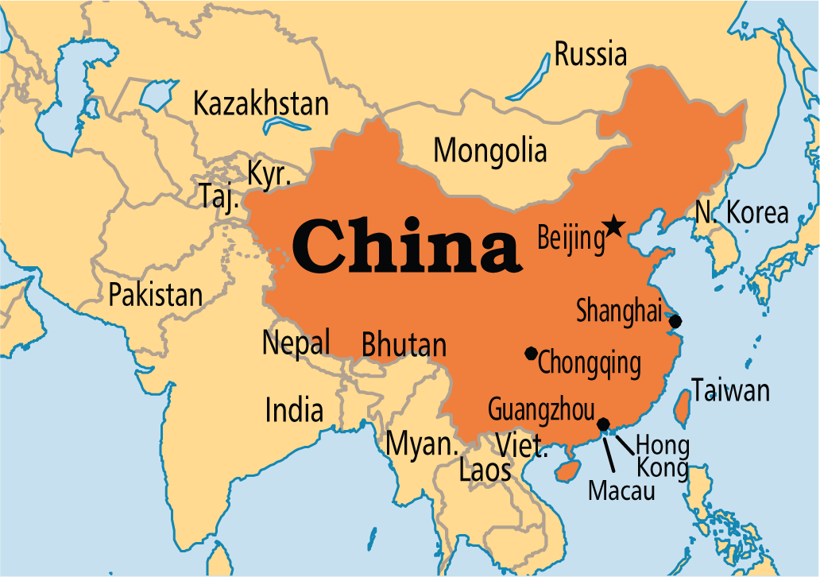
CHINA

Slide 2
Third largest country in the world
Has all kinds of weather-varies depending on the region
Divided into twenty-two provinces
Eight main land regions

Slide 3
East Coast
Area of farmland, cities, and waterways
Known for their silk farms
China’s capital city-Bejjing
2 Rivers- the Huang Ge and the Yangtze meet at the China Sea
Yangtze is the fourth-longest river in the world
It flows through gorges
Gorges-narrow valleys with steep walls

Slide 4
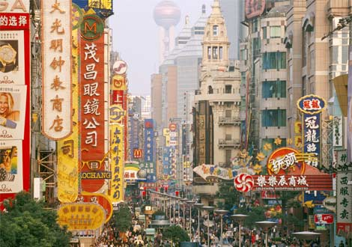
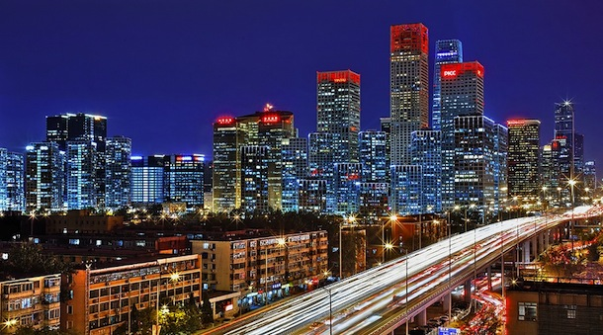

Slide 5
West and north
West-mountains
North-dry deserts and grassy plains
Tibet
Plateau covered by grassland
Surrounded by mountains on three sides
Mount Everest –tallest mountain on the planet

Slide 6
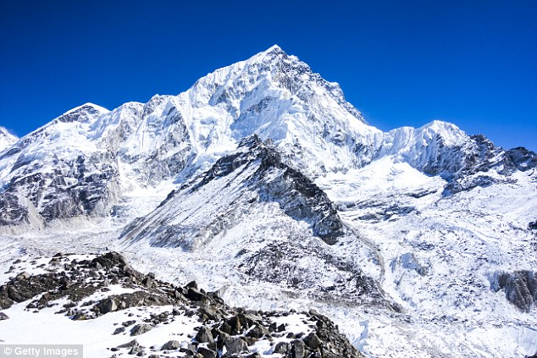

Slide 7
Northern China
Northern China- Gobi desert
Largest desert in Asia
Means “very large and dry”

Slide 8
Plains
Northern China has large plains
Above the plains are steppes-lands that are dry and windy

Slide 9
China’s central land
Area for agriculture
Hills and valleys

Slide 10
South-Central China
Sichuan Basin-protected from the wind
Much of China’s rice is grown here

Slide 11
Called “Rice Bowl”
Basin-rounded lowland

Slide 12
South-Province of Yunnan
Most of China’s most unusual scenery

Slide 13
The History of China
Chinese culture-owes its beginnings to ancient peoples
Farmers built houses and made metal tools
1st people’s to know how to develop writing

Slide 14
Chinese Empire
Dynasty- ruling families
Controlled China
221BC-empire (Qin Dynasty) united the land

Slide 15
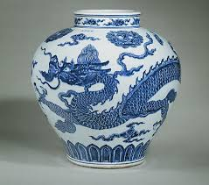
Chinese rulers became known as emperors
Porcelain-fine thin pottery made from white clay
Invented in China

Slide 16
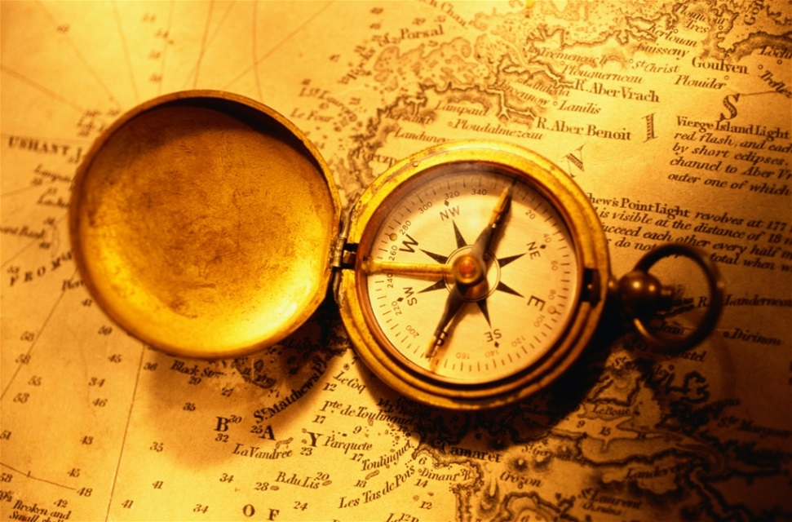
Compass-instrument for showing directions

Slide 17
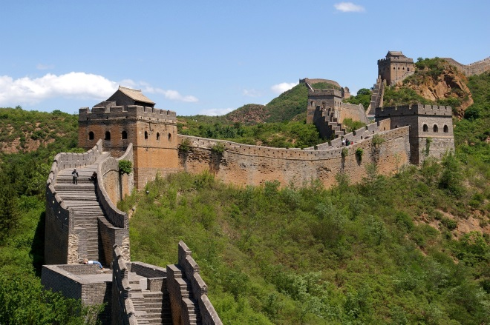
Great Wall of China
Located in the north of China
Meant to protect the Chinese empire from northern
invaders

Slide 18
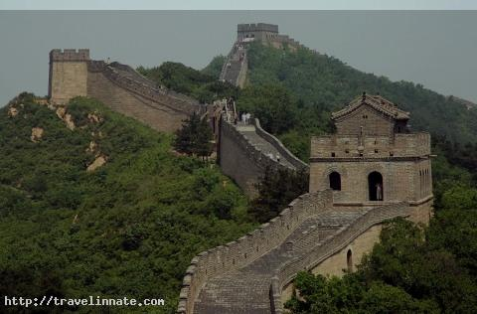
Great Wall of China
Expanded over hundreds of years
About 1500 miles
long

Slide 19
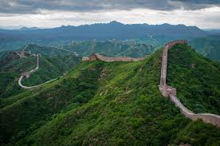

Slide 20
1800s-Chinese people did not like the emperors
Taipings rebelled or fought back against the Qing Dynasty

Slide 21
Rebellion was unsuccessful
Imperial-one emperor rule
Was losing power
By 1912, Pu Yi, the emperor was forced to give up the throne

Slide 22
Revolution
1911- a revolution ended dynasty rule
Nationalists set up a national state with a president

Slide 23
Did not last for a long time
Moved to Taiwan and set up a government there

Slide 24
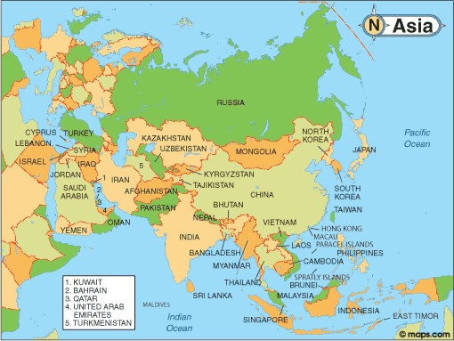

Slide 25
Communists –took over
Fought the Nationalists in a Civil War and won
Renamed China-The People’s Republic of China

Slide 26
Communism- a government system in which property and goods are owned by the government and to be shared equally by everyone

Slide 27
Ruled by a communist party
Political Party –a group that directs government

Slide 28
Educating the People
Chinese culture sees learning as important
Confucius- one of the most famous Chinese scholars, taught that you could improve yourself through study

Slide 29
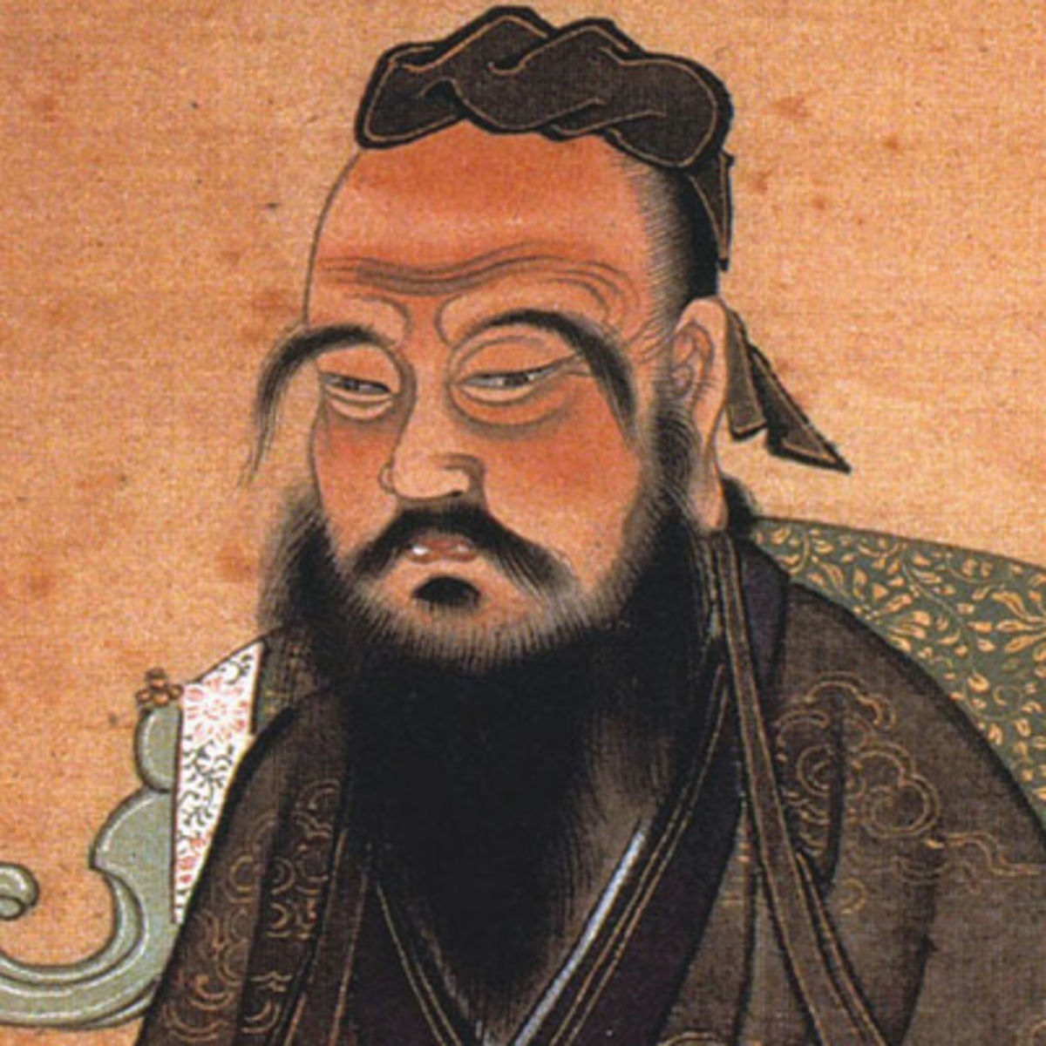

Slide 30
Re-education-convincing people that communism was the best system of government
For adults and children

Slide 31
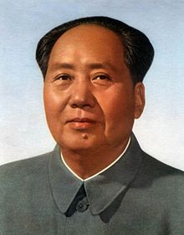
Everyone was taught to follow the communist leader Mao Zedong

Slide 32
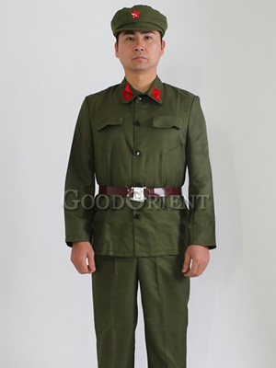
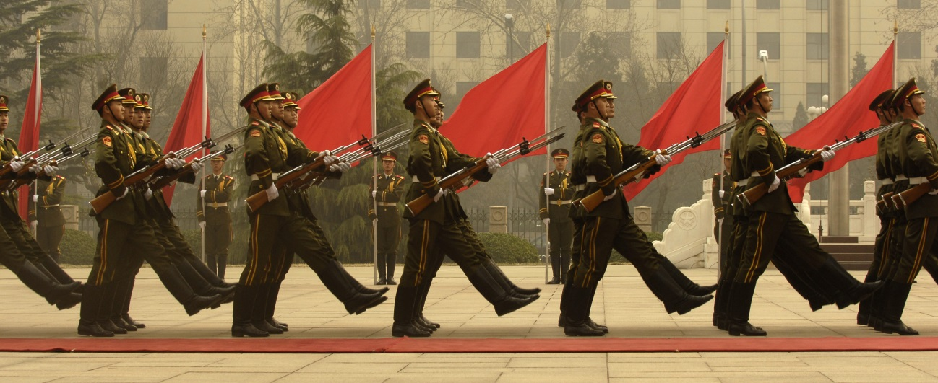
Red Guard-organization to support the Communist Party

Slide 33
1986-Chinese government passed a law saying that children must go to school for at least 9 years

Slide 34
School is free (for the first 9 years) but parents have to pay for books, food, transportation & sometimes heat

Slide 35
A Land of Riches
Technology- the knowledge and skills to make something

Slide 36
Silk Road-series of routes that allowed China to trade with Europe and Asia

Slide 38
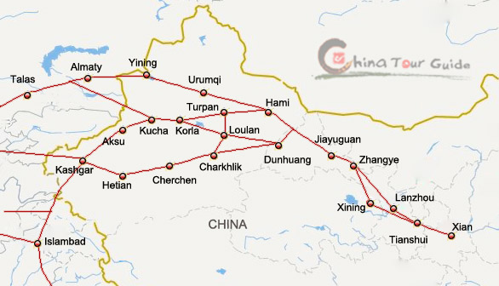

Slide 39
Eastern China-a giant waterway, Grand Canal, was built to make shipping easier

Slide 40
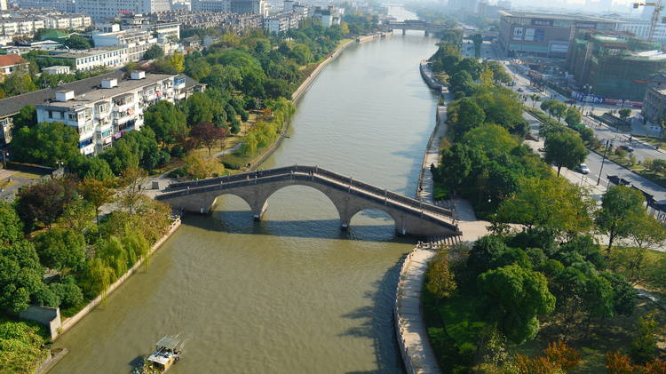

Slide 41
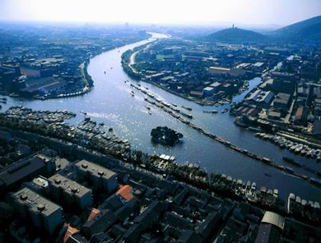

Slide 42
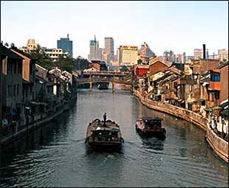

Slide 43
China’s Resources
Largest reserve of coal in the world
Minerals are mined

Slide 44
Variety of plants and wildlife
Medicinal herbs

Slide 45
China’ rice harvest is the largest in the world
top fishing nation

Slide 46
China’s economy saw a boom-a time of quick growth
Tourism-business of hosting visitors

Slide 47
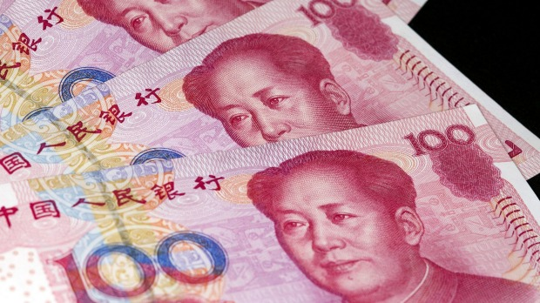
The yuan is China’s money

Slide 48
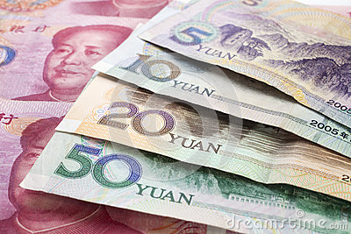

Slide 49
Dam-a wall or structure built across a river to hold back and control the water

Slide 50
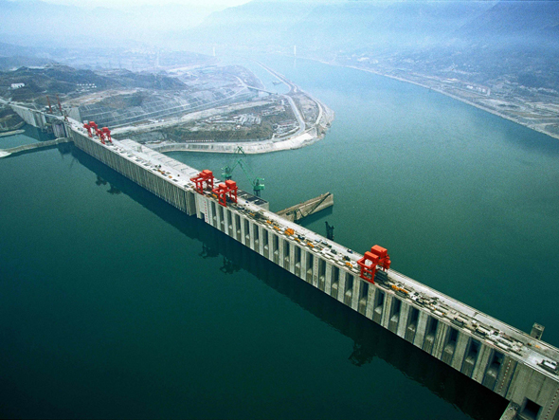

Slide 51
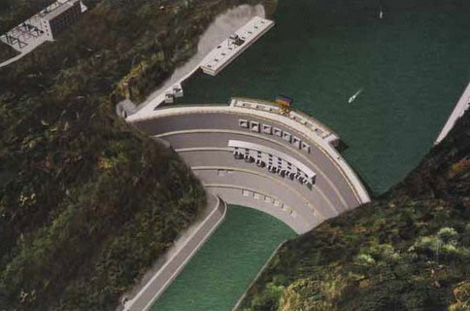

Slide 52
Boom in industry-more power is needed to run factories, cars, and homes

Slide 53
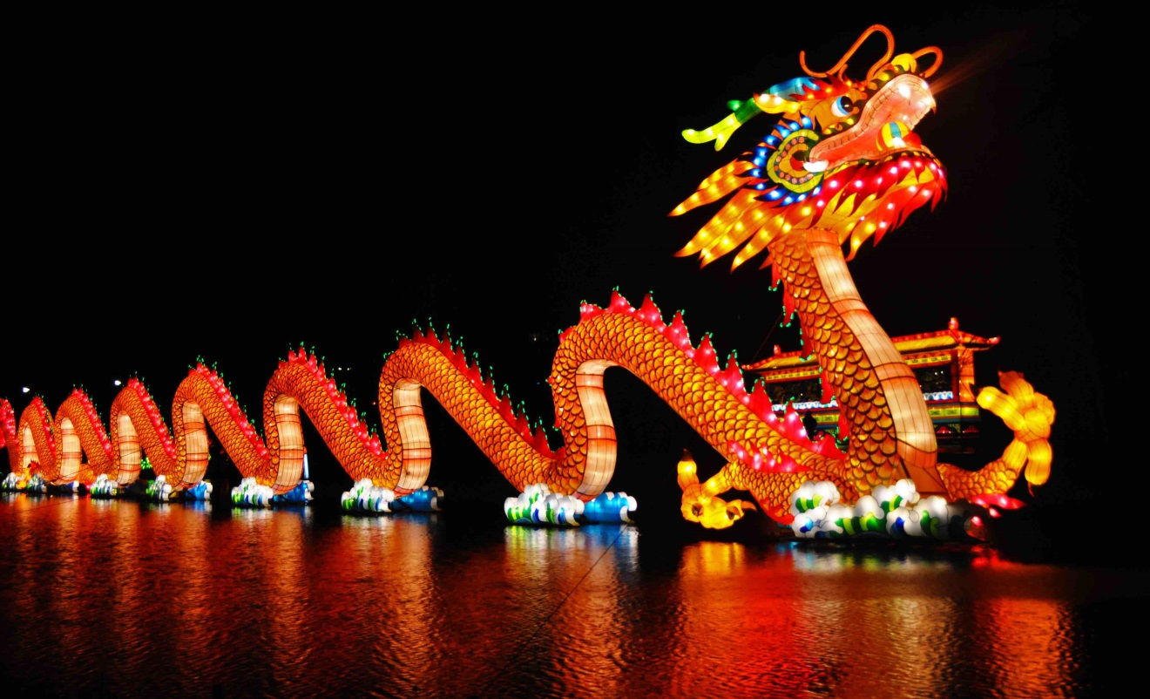
Living in China
Celebrate festivals during the year

Slide 54
Chinese New Year
Most important holiday
Falls in January or February every year and lasts for 15 days

Slide 55
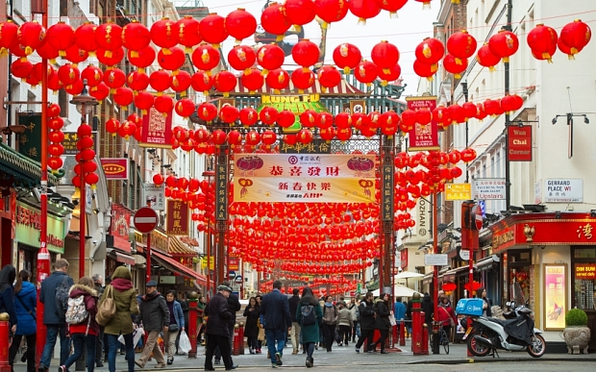

Slide 56
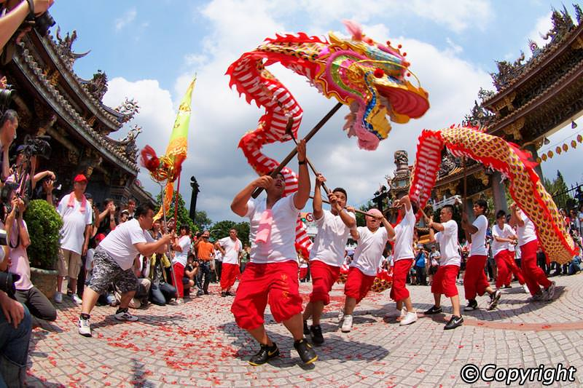

Slide 57
Families enjoy a large feast together
make wishes and prayers and honor those who have died

Slide 58
Architecture- the style of its buildings
Pagodas-old, wooden temples with graceful roofs that curve upwards

Slide 59
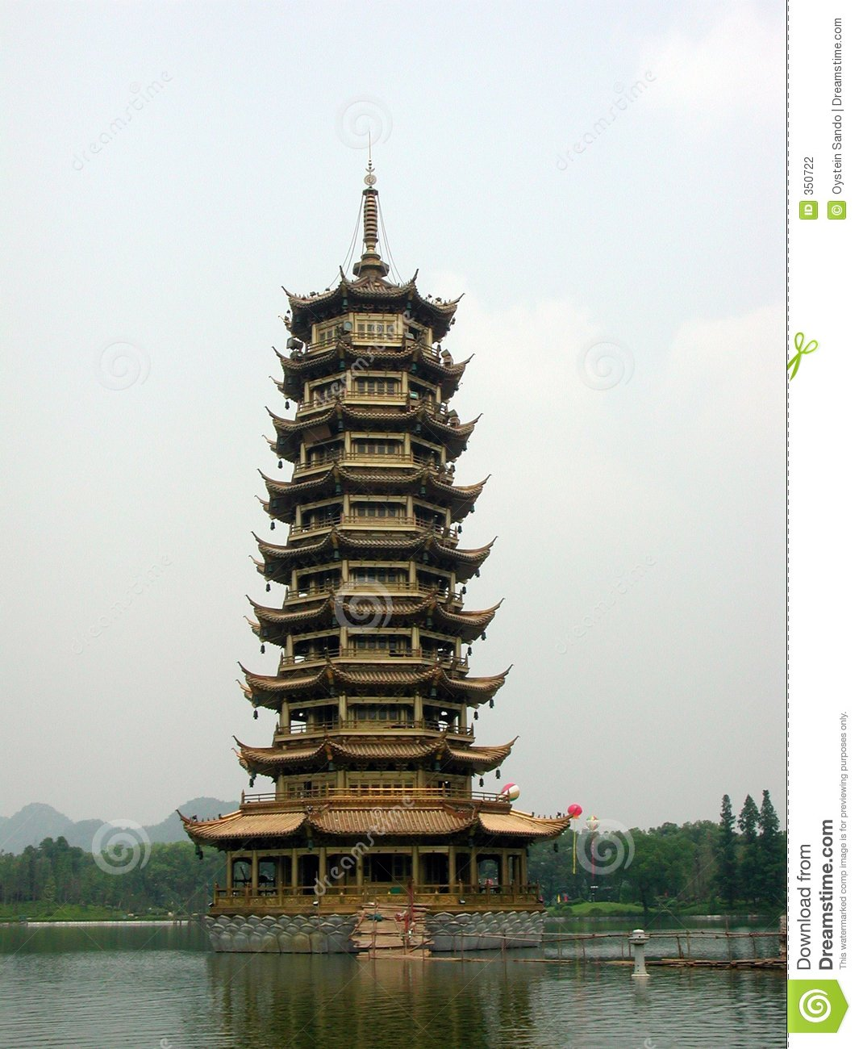

Slide 60
Many of China’s arts are based on ancient ways

Slide 61
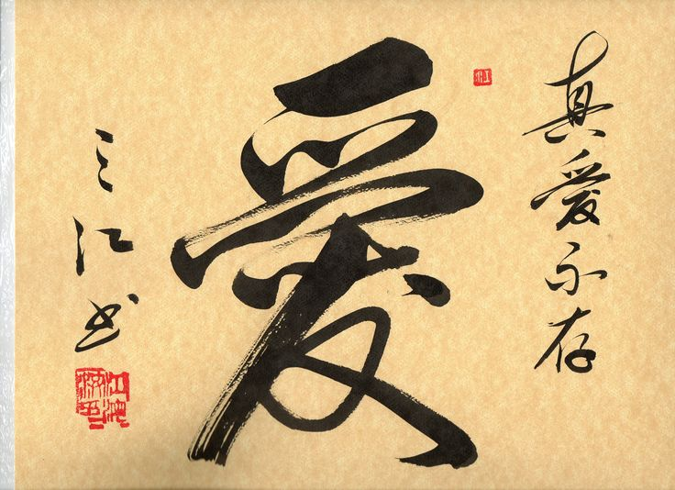
Chinese calligraphy-beautiful writing
Considered art

Slide 62
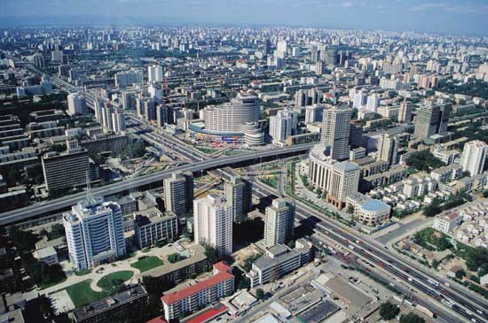
Has some of the largest cities in the world

Slide 63
Courtyard-an open area surrounded by buildings
Center of daily life
People do their washing, sewing and cooking

Slide 64
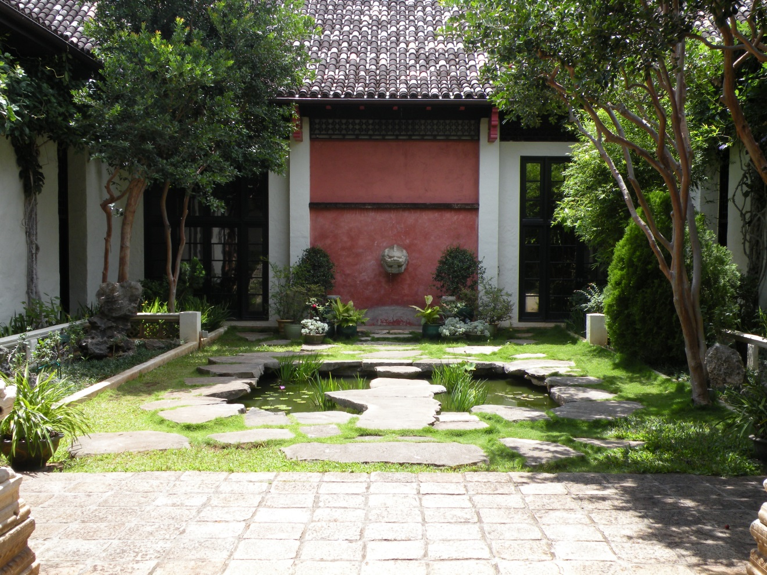

Slide 65
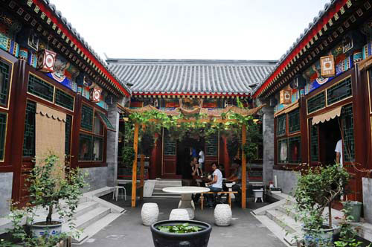

Slide 66
Everyone in a farming village works hard and cooperates or helps each other

Slide 67
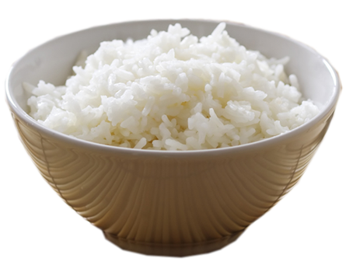
Every day, the Chinese people eat 3 billion bowls of rice

Slide 68
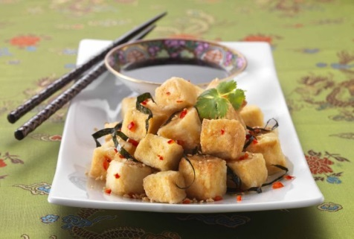
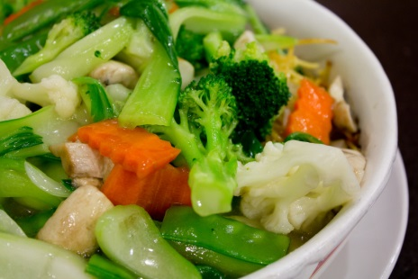
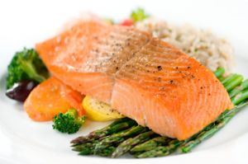
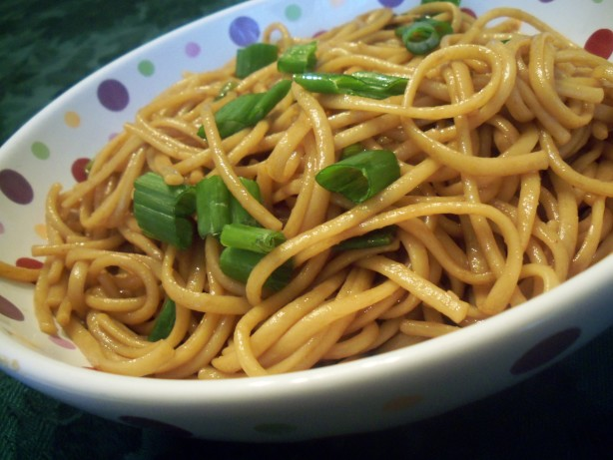
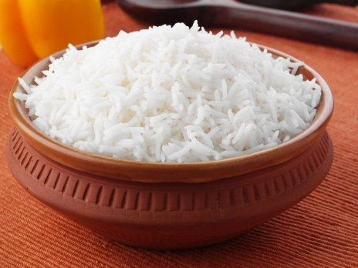
Rice, noodles, vegetables, fish and tofu are common foods

Slide 69
Beijing- China’s Capital
Streets are crowded
Take the subway called the Underground Dragon

Slide 70
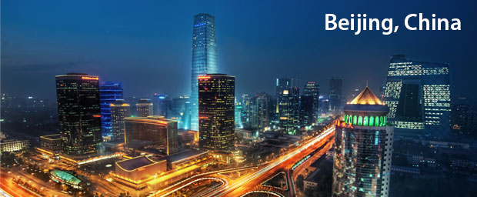

Slide 71
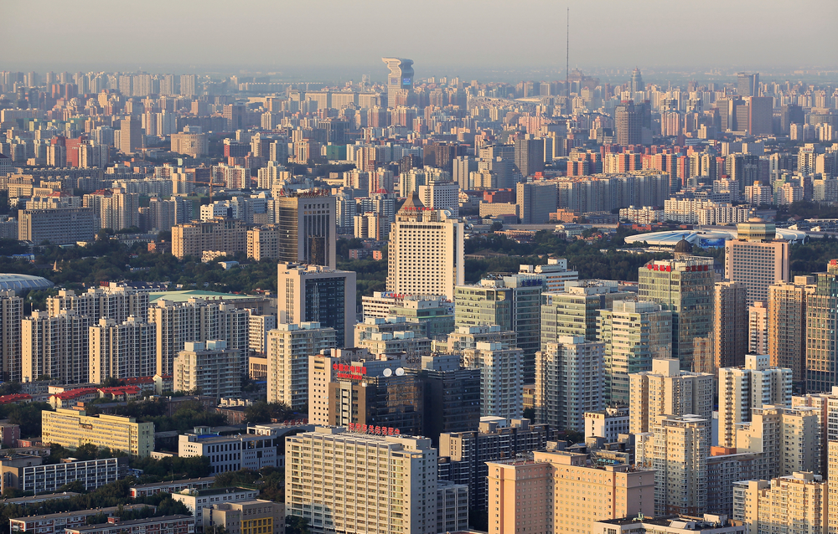

Slide 72
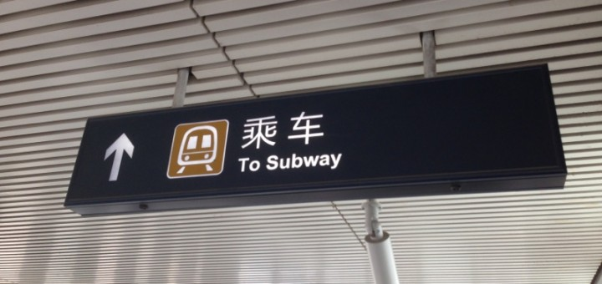
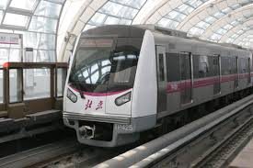

Slide 73
The End
Take out your planners-
Test on Monday April 3rd

