Slide 1
Chapter 6
A NEW STATE

Slide 2
13 colonies became 13 independent states
Each state was to create a government
convention- a formal meeting held for a special purpose
1777-Kingston was NY’s capital
Capital-the place where government leaders meet
Representatives- people elected to speak or vote for others

Slide 3
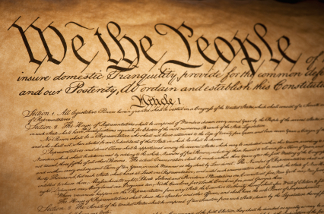
Constitution-plans of government
1797-capital was moved from Kingston to Albany
Nation-the people of an area who live under 1 government and share a history and culture

Slide 4
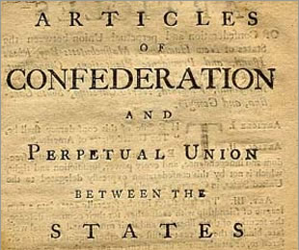
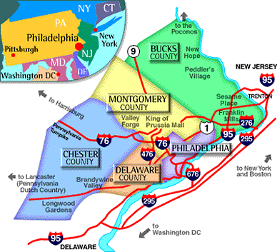
Articles of Confederation
1st national plan
Showed weakness
Delegates came together in Phil.
Remembered the rules of the Iroquois League

Slide 5
U.S. Constitution- a set of rules that explain how power is distributed across the branches of national government
Amendments-changes or additions to the Constitution
July 1788-NY-11th state to ratify or approve the Constitution

Slide 6
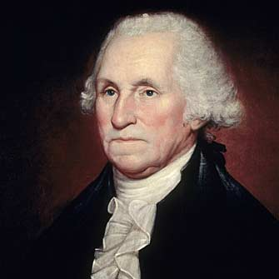
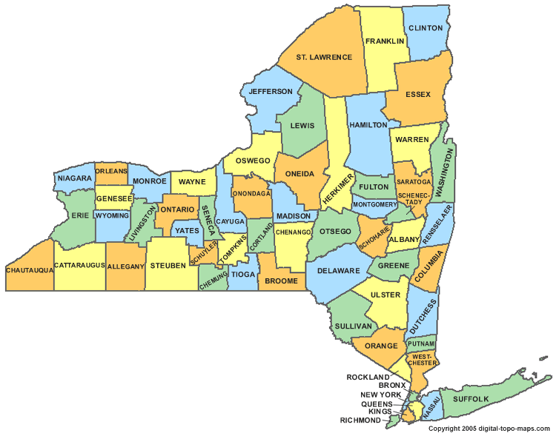
1st 10 Amendments-Bill of Rights
Rights of ordinary citizens
1789- George Washington-1st President of the US
NYC-nations capital

Slide 7
Trade- buying and selling of goods
Empress of China- opened trade between the US and China
Entrepreneurs- people who start and run their own business
Free enterprise- a system in which business flows freely
The government does not have a say in business

Slide 8
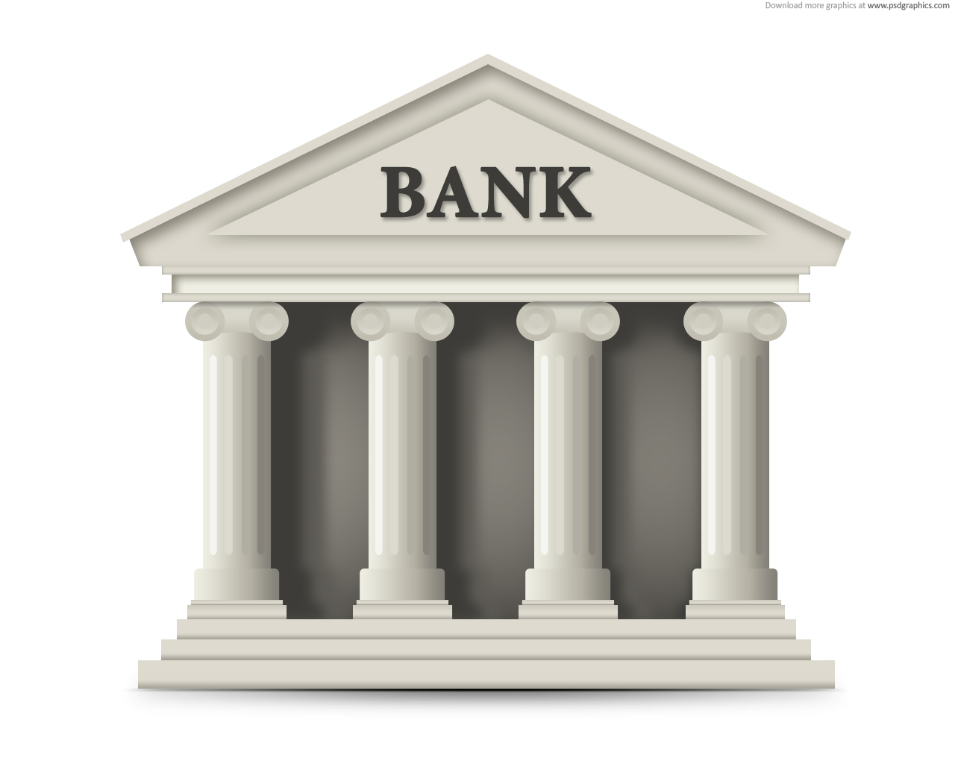
Bank- a business that helps people borrow and save money

Slide 9
Alexander Hamilton- started the bank of NY
Great Western Turnpike Co- became US
Route 20

Slide 10
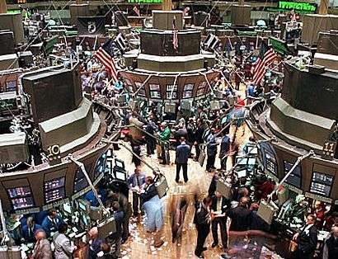
stock- a share of a company and the money it makes
1st stock market exchange-set up- called the Buttonwood Agreement

Slide 11
The End
Test to Follow!!

