Slide 1
Chapter 5 The American Revolution

Slide 2
French & Indian War
Algonquian & French vs Iroquois & British
Began in 1754
Many battles fought in NY colony
1763-Treaty of Paris ended the war & gave British control of all French Canada

Slide 3
French and Indian War was expensive
Britain needed money to pay these costs
1765- gov’t passed the stamp act- a law that placed a tax on paper sold in the colonies
Patriot- people who did not remain loyal to Britain
Loyalist- people who remained loyal to Britain

Slide 4
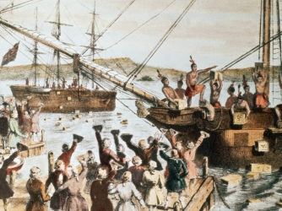
Tea tax- tax on tea
Boston Tea Party- a protest when colonists boarded a British ship and threw all the tea into the harbor

Slide 5
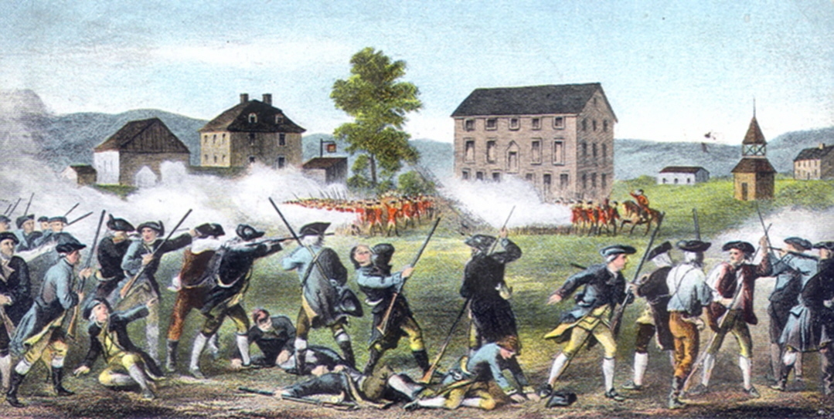
Militias- citizen armies
April 19, 1775-”shot heard round the world” at Concord
Began the revolution- the colonists fight for freedom

Slide 6
Patriots from the 13th colonists sent delegates- people chosen to represent a group to PA
Known as the Continental Congress
Voted to break away from Great Britain
Wrote the Declaration of Independence

Slide 7
George Washington- named Commander and Chief of the Continental Army
NY- important bc it was between colonies in the North and South
Retreat- give up ground
Surrender- give up
British captured the American capital at Philadelphia--1777

Slide 8
Sybil Ludington- warned the American army that the British were burning Danbury
Battle of Saratoga
British planned to attack American colonists at Saratoga
1 army came from Canada
1 army from NYC
Army never left NYC

Slide 9
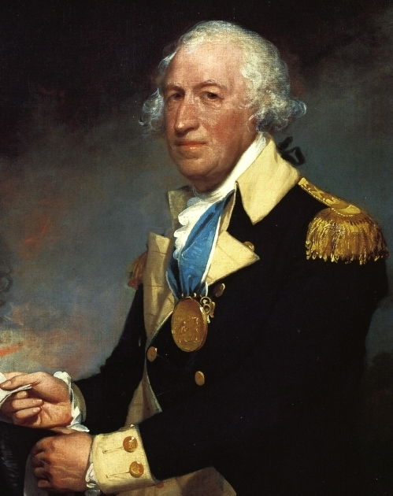
American general Horatio Gates defeated the British army at Saratoga

Slide 10
Battle of Saratoga convinced the French king to sign a treaty – written agreement between 2 countries
French agreed to send troops & supplies to help the Americans

Slide 11
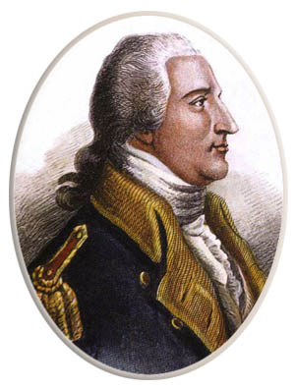
Traitor- someone who acts against his own country
Benedict Arnold- America’s most famous traitor

Slide 12
Battle of Yorktown
Yorktown, Virginia
With the French help- America won the Battle

Slide 13
Oct. 19, 1781- General Cornwallis surrendered
Sept. 3, 1783- Peace of Paris officially ended the war
Treaty recognized the independence of the US
Alexander Hamilton- wrote essays to persuade people to accept the new Constitution

