Slide 1
Chapter 4 Life in colonial ny

Slide 2
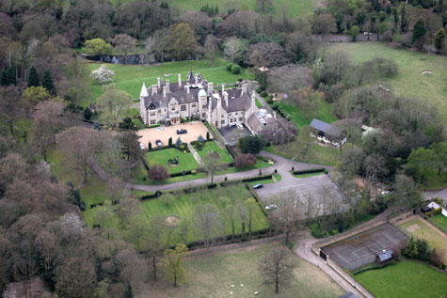
Surplus- more than needed
Manors- large pieces of land divided into several farms & rented by landowners to farmers

Slide 3
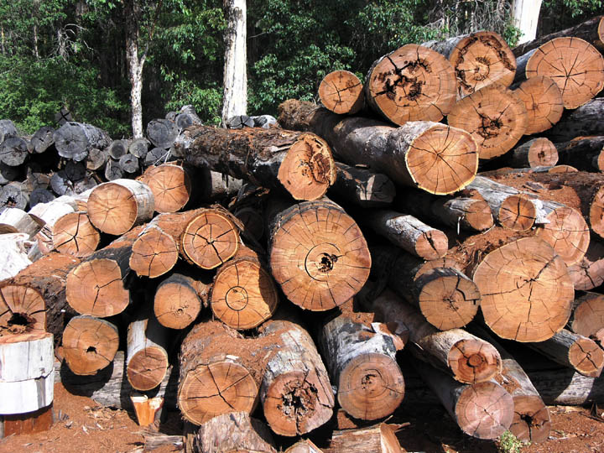
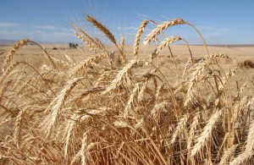
Merchants-people who buy & sell goods
Exported- something sold or traded to another country
Wheat, fur, meat, lumber

Slide 4
Imported- something brought into a country for sale
Ex. Glassware, china
Indentured servant- employer paid for the servant to come to the colonies- the servant had to work a certain number of yrs before they were free

Slide 5
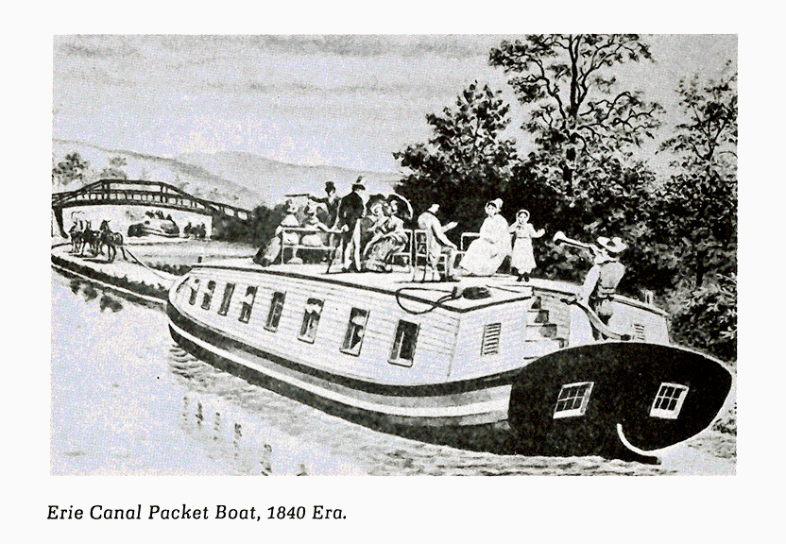
Packet boats- boats that carried letters & other goods from England

Slide 6
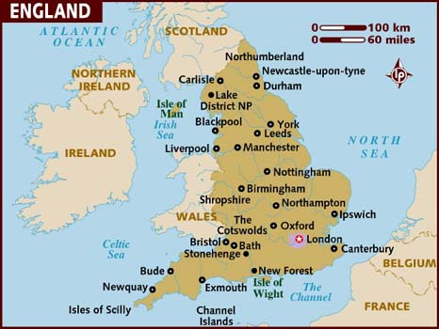
Dutch colony of New Netherland becomes the English colony of NY
1707-England & Scotland joined to become the Kingdom of Great Britain

Slide 7
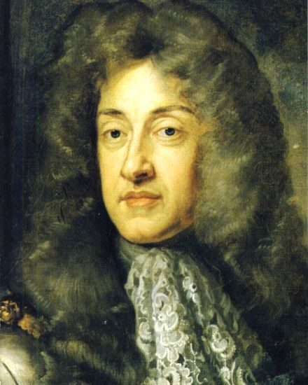
1685- Duke of York becomes King James II of England
NY became a royal colony- colony belonged to the king and queen

Slide 8
Sheriffs- country officials who made sure that laws were obeyed
NY citizens could not vote in elections for Parliament
Government- system which runs a country, state or city

Slide 9
Legislature- a group of elected citizens to make laws
Assembly-members of a legislature
Taxes- money collected to pay the cost of government

Slide 10
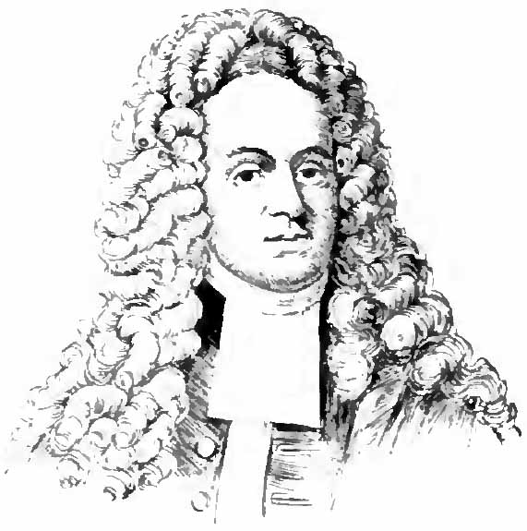
John Peter Zenger- on trial for stating his opinion
His case helped create freedom of press in America

Slide 11
The Iroquois- allies- friends with the British
Triangle Trade- a slave trade that ran from Africa to the Caribbean Sea to the American Colonies

Slide 12
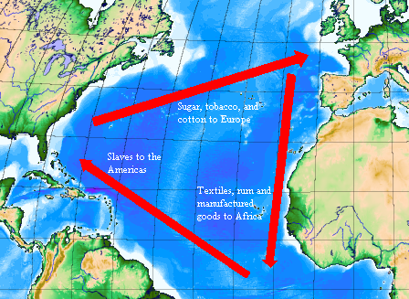

Slide 13
Colonial NY
Everyone worked-even children
Everything made by hand
Sunday-no work- Church

Slide 14
Market economy- an economy in which people decided for themselves what to sell or buy
1700s- British gov’t took away people’s rights (women, the enslaved, children)

Slide 15
Trouble with France
New France had a fort on Lake Champlain-was a threat b/c it could cut off communication by land between the New England colonies & the British colonies to the south

Slide 16
1754- French & Indian War
1759- Quebec was captured
French lost their colony in Canada forever
War ended in 1763- British won
Algonquians & French vs. Iroquois & British

Slide 17
British gov’t needed money
Decided to raise taxes in the colonies
This would be the main cause of the American Revolution
No taxation without representation

