Slide 1
Chapter 2 NY States Early People

Slide 2
40,000 yrs ago, climate on Earth-colder
Bridge of ice btw Asia and N. America
12,000 yrs ago, people settled in NYS
Archaeologist- a scientist who studies artifacts
Prehistory-the time before written records

Slide 3
1st people who lived in NY were hunters
Animals for food and clothes and tools
Hunter-gatherer-people who find food both by hunting animals and gathering food
Life centered around family

Slide 4
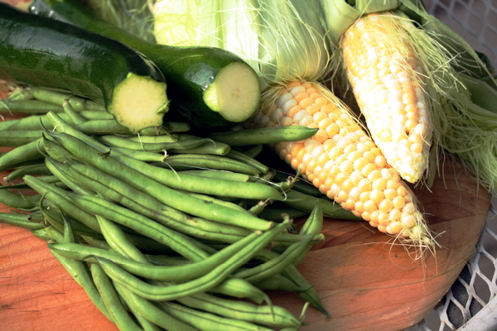
11,000 yrs ago-Earth got warmer
Ice melted-formed lakes and ponds
Agriculture-growing crops and raising animals
Ex. Corn, beans, squash

Slide 5
Eastern Woodlands-Mississippi to the Atlantic Ocean
Heritage-the history, traditions, beliefs, and customs shared by a group of people
2 Native American groups
Grouped by the language they spoke
Algonquian
Iroquois-”red snakes”
Called themselves Hodenosaunee- people of the longhouse

Slide 6
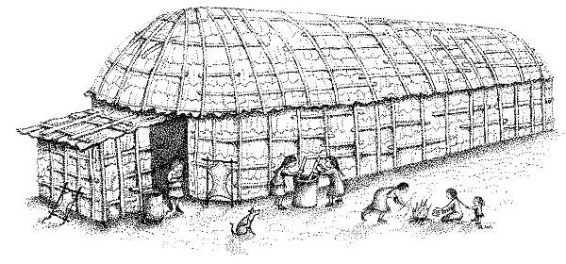
Longhouse-a long wooden building housing more than 1 family
Iroquois lived in longhouses

Slide 7
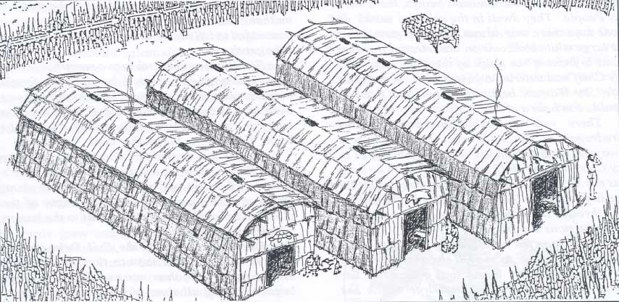

Slide 8
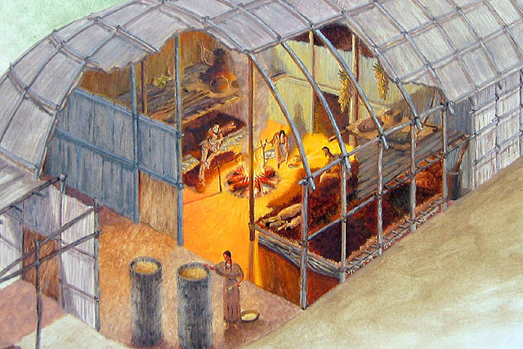

Slide 9
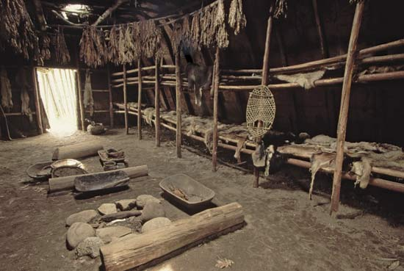

Slide 10
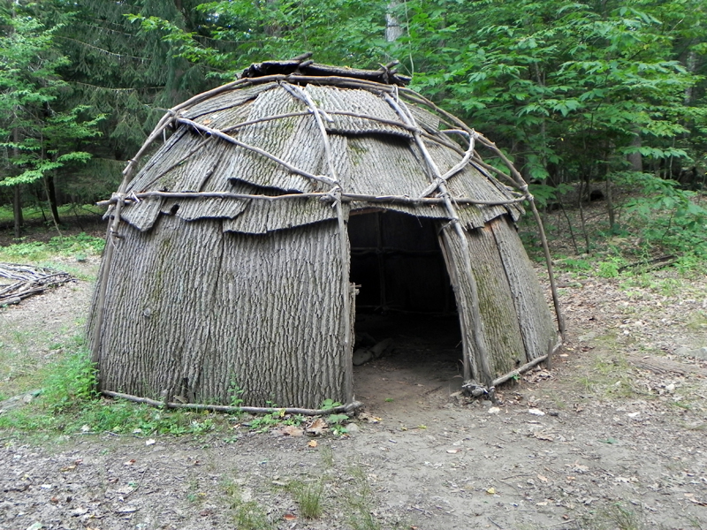
Wigwam-smaller house made of arched poles and bark
The Three Sisters-corn, bean, squash

Slide 11
Men-fished, hunted, traded
Built houses and defended the village
Women-planted & harvested crops
Cooked, cleaned, cared for the children
Children
Boys-learned to hunt & build shelters
Girls-learned to cook, make pottery & clothing

Slide 12
Native Americans use stories to tell history
Ancestor- a person in a family who lived in the past
Many Native Americans live on reservations- land set aside by the US gov’t for Native Americans to use
Lacrosse-invented by N. Americans

Slide 13
Iroquois groups fought with each other
1570-Great Peace- 5 Iroquois groups agreed to stop fighting
Deganawida-stop fighting and work together in peace
Iroquois League-Mohawk, Seneca, Cayuga, Oneida, Onondaga

Slide 14
League-a group of people who join together for a common goal
1722-Tuscarora joined
Iroquois League is also called the 6 Nations

Slide 15
Deganawida- wanted the Iroquois to stop fighting
Tree of Great Peace
Tree symbol of the strength of the Iroquois League

Slide 16
Rights of the Iroquois League
Right to speak freely
Right to food, clothing, shelter
Right to practice their own religion
Clan- a group of people who share the same ancestors

Slide 17
council leaders-made decisions and plan
Respected older GRAND clan
People-gave COUNCIL mothers-appointed
Advice council leaders
Village members-attended councils and had the right to speak

Slide 18
Council-group of people who meet to talk and make decisions
Had the power to keep peace & protect the people of the league
50 members of the Grand Council-called sachem
Settled differences btw nations
Wampum- a string of polished beads made from shells

Slide 19
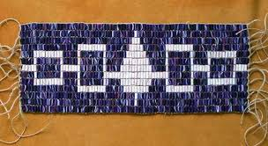
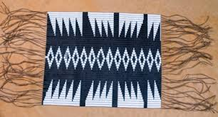
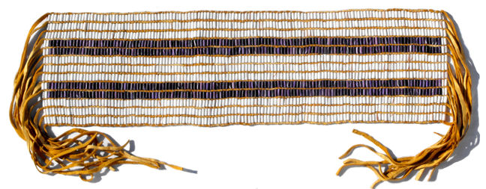

Slide 20
Iroquois League still exists today
Many live in NYS
Grand Council continues to meet in Onondaga
Hiawatha
Member of the Onondaga group
Convinced Iroquois nations to join a league
League’s laws are based on fairness & justice

