Slide 1
Chapter 11
Governing New York

Slide 2
Government-the laws and people that run a country, state, or town
Municipal Government-the local government of a city, town or village

Slide 3
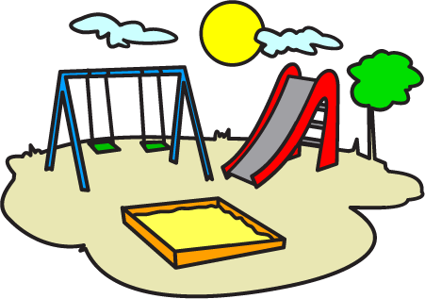
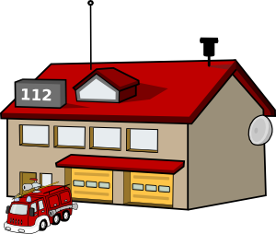
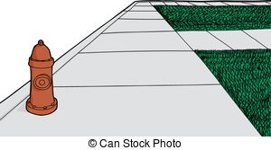
Local Government
Run police and fire department
Care for sidewalks and streets
Run library and public parks

Slide 4
Elected-to choose by voting
Mayor-the head of a municipal government

Slide 5
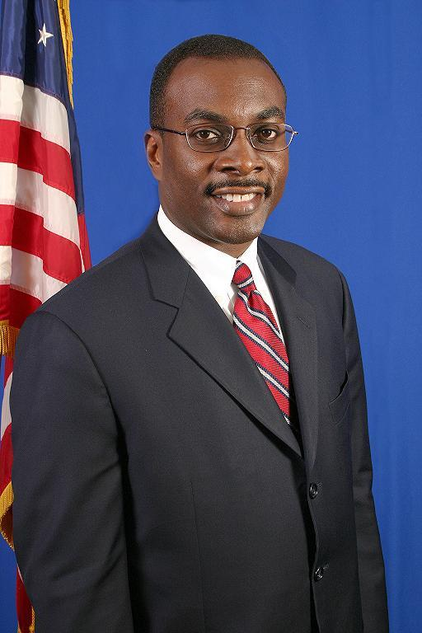
Mayor of Buffalo-Byron Brown

Slide 6
City council-group of people who meet to make decisions for the city
City manager- an expert hired to run the daily business of a city

Slide 7
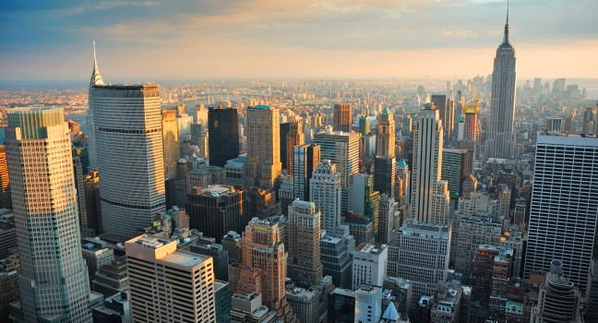
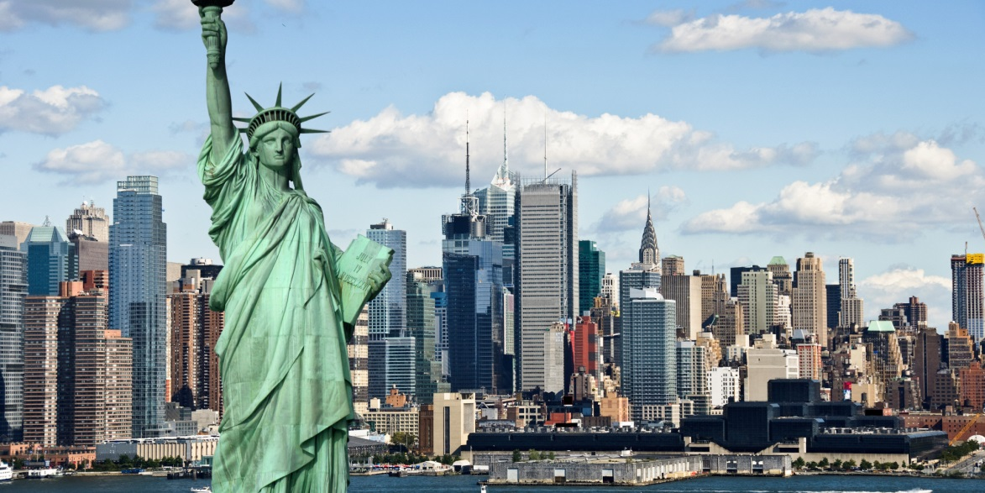
NYC-biggest city in the state

Slide 8
County-a political division of a state
Include cities, towns, and open areas
Every county has a government
Care for roads and protect people

Slide 9
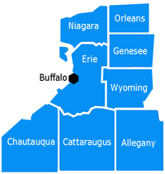

Slide 10
State Government
State government is a democracy-a system in which citizens vote for their government representatives
Made up of 3 parts

Slide 11
Each part or branch-has different duties or powers
No 1 branch has all the power
Called checks and balances

Slide 12
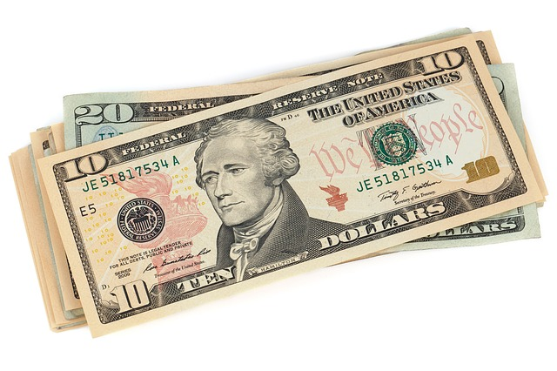
Budget-plan for spending money

Slide 13
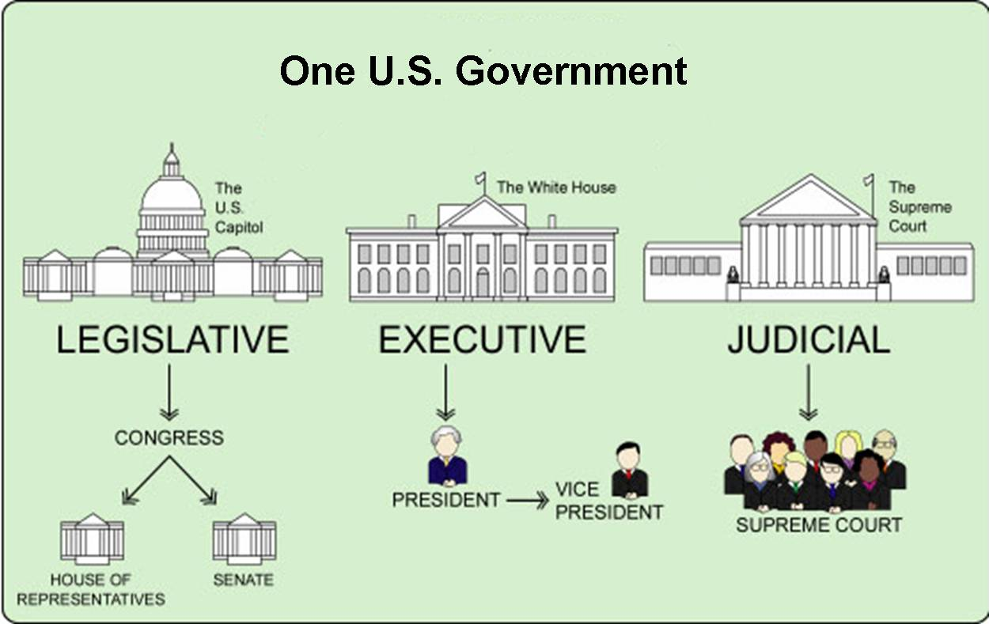

Slide 14
Three Branches of State Gov’t
Legislative Branch
Makes the laws
Made up of 2 parts
State Senate
State Assembly (House of Representatives)
Elected for 2 years

Slide 15
Anyone can suggest a law
Bill-a written idea for a law
Bill is introduced to the state legislature
Is passed-goes to the governor
Governor-sign and make it a law
Or
Veto(refuse to approve a bill) the law

Slide 16
Executive Branch
Make sure the laws are followed
Plans the state government
Head-governor
Elected every 4 years

Slide 17
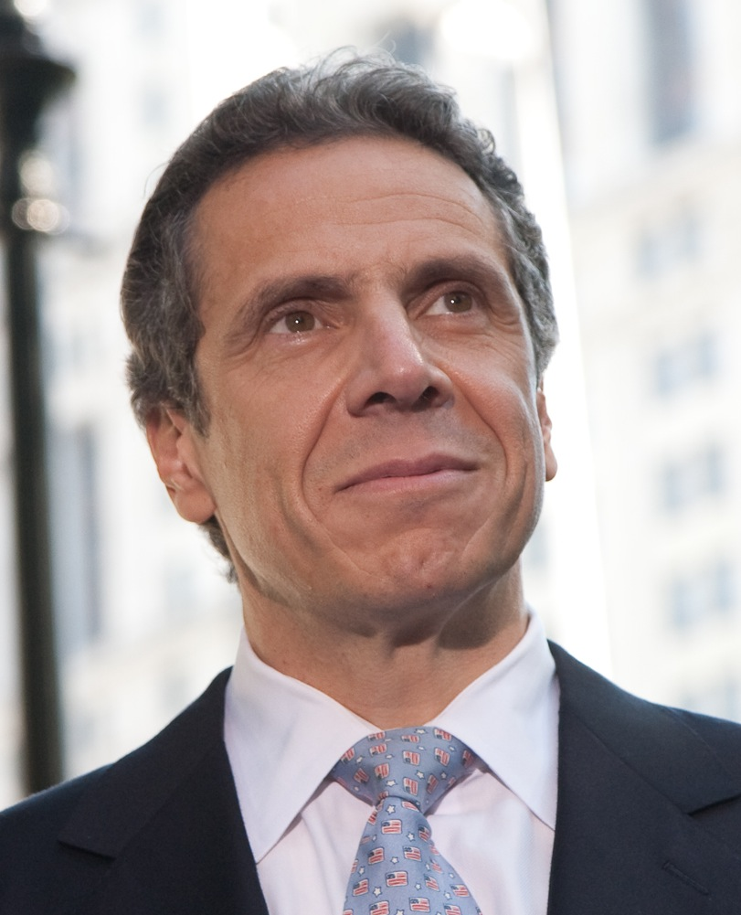
Governor of NY-Andrew Cuomo

Slide 18
Judicial Branch
Decides if someone has broken the law
Interprets the laws of NYS
Works for justice

Slide 19
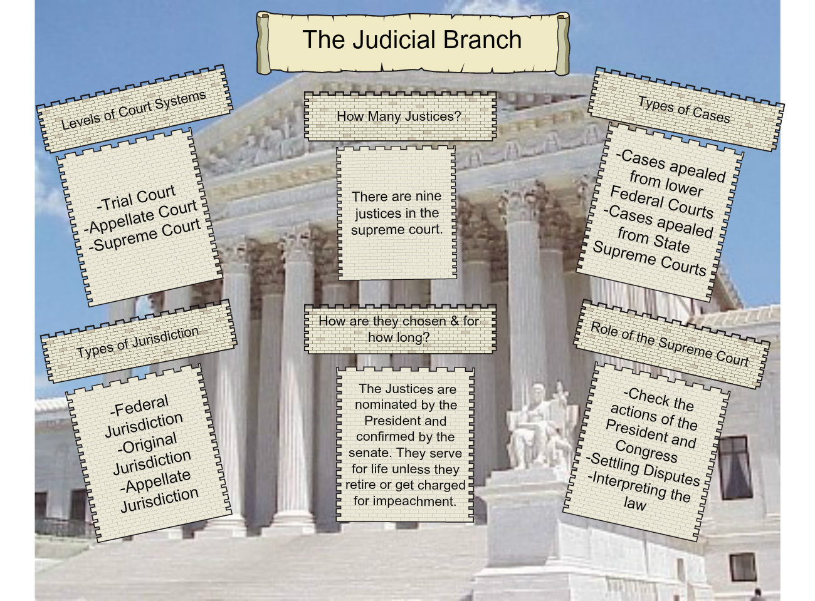

Slide 20
Most powerful court in NY-Court of Appeals
Judges serve for 14 years
Decide whether decisions made in the lower courts are correct

Slide 21
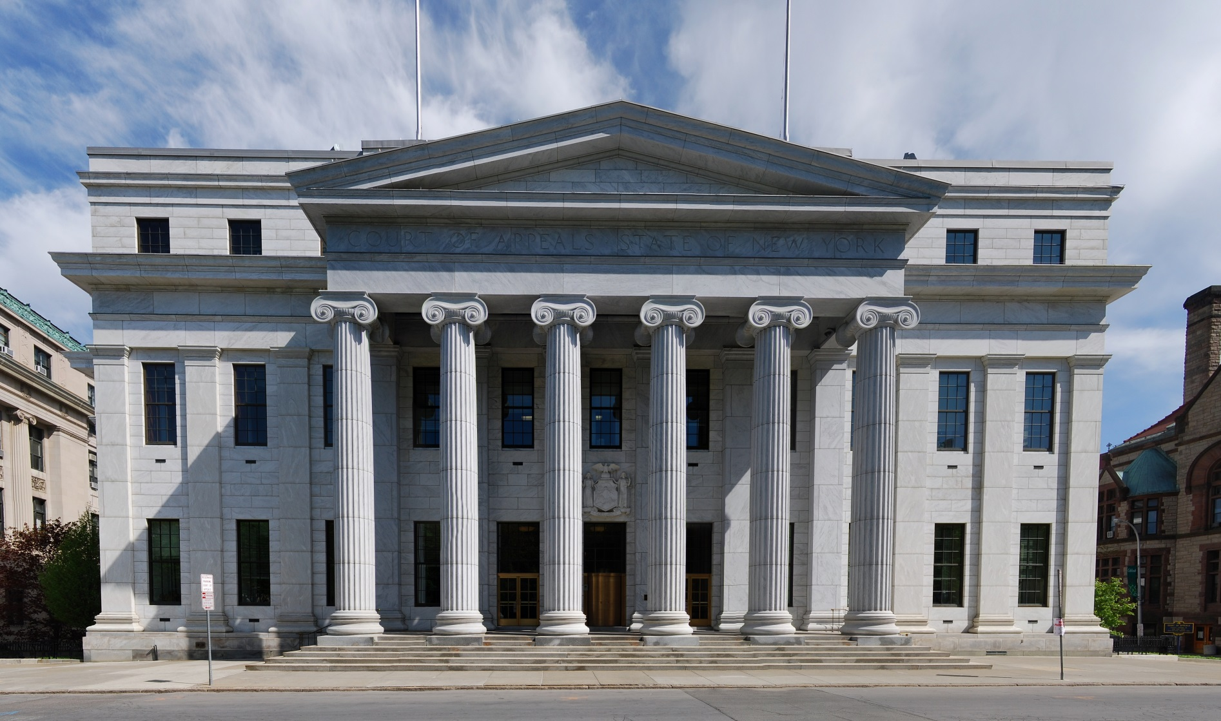
NY State Court of Appeals Building

Slide 22
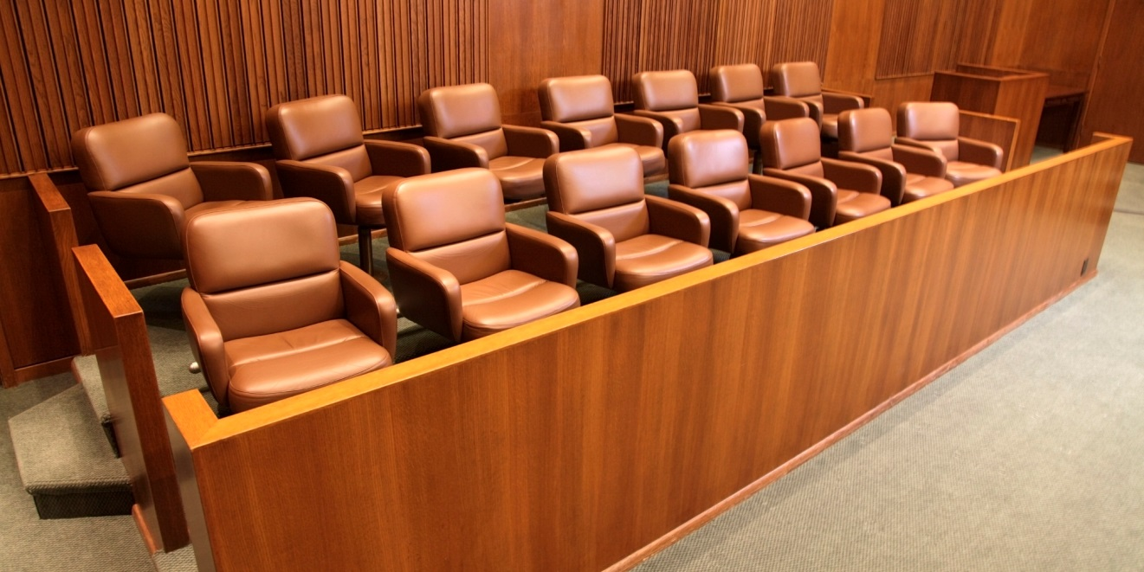
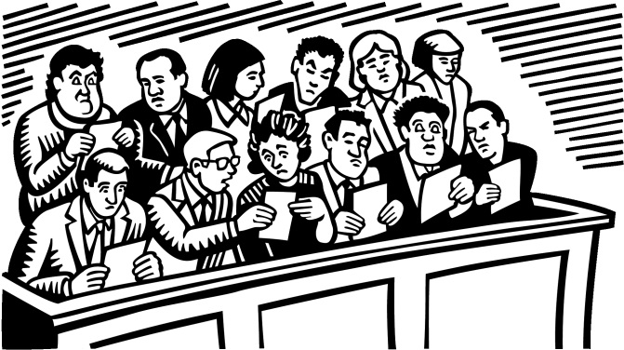
Jury-group of 12 citizens who are chosen to decide on a case in a court of law

Slide 23
Our National Government
Called the National or federal government
Citizen- a person who is born into a country or who has earned the right to become a member of the country by law

Slide 25
Bill of Rights-first 10 Amendments to the US Constitution

Slide 26
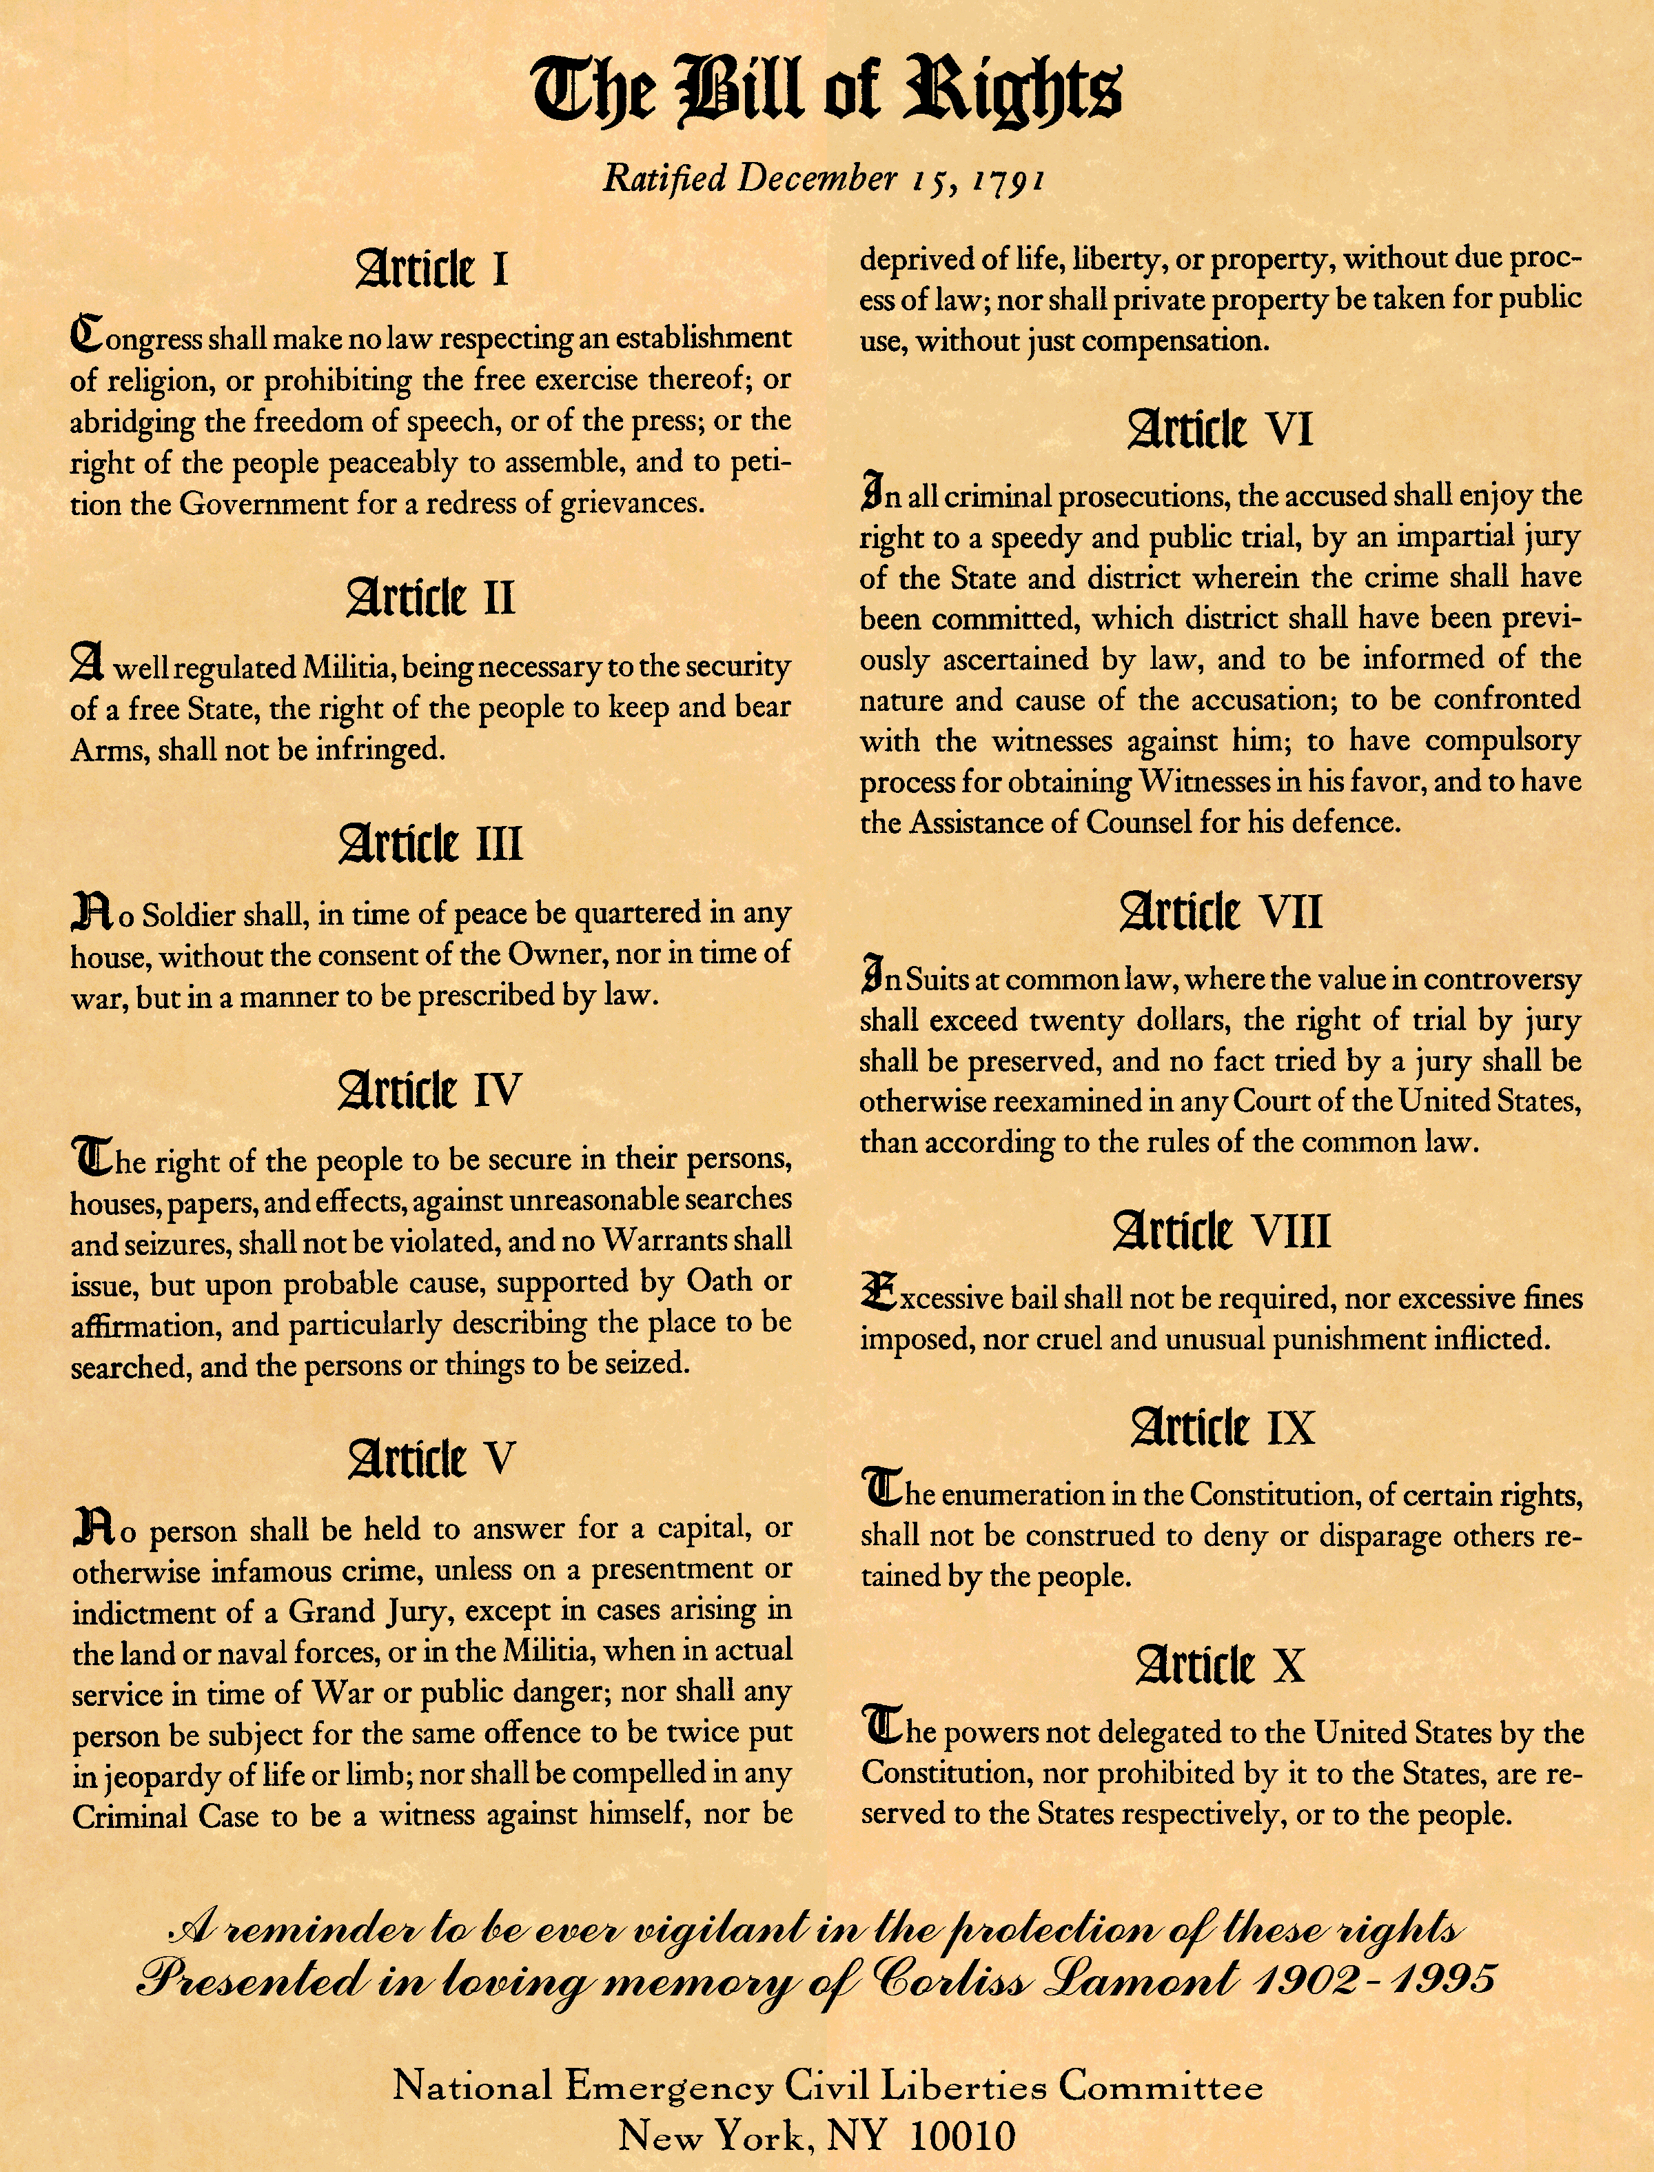

Slide 27
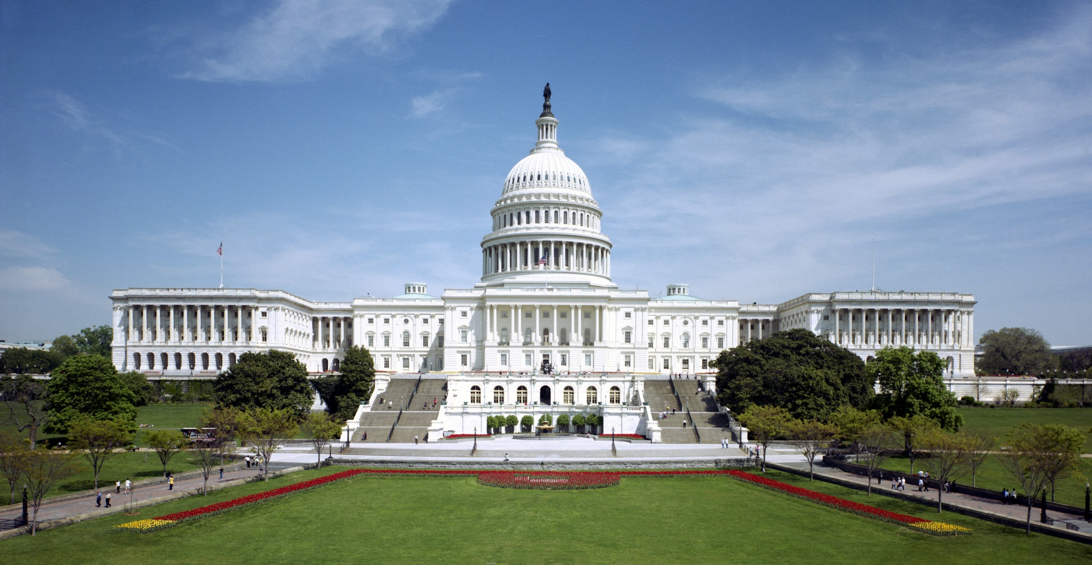
Nations Capitol is Washington D.C.

Slide 28
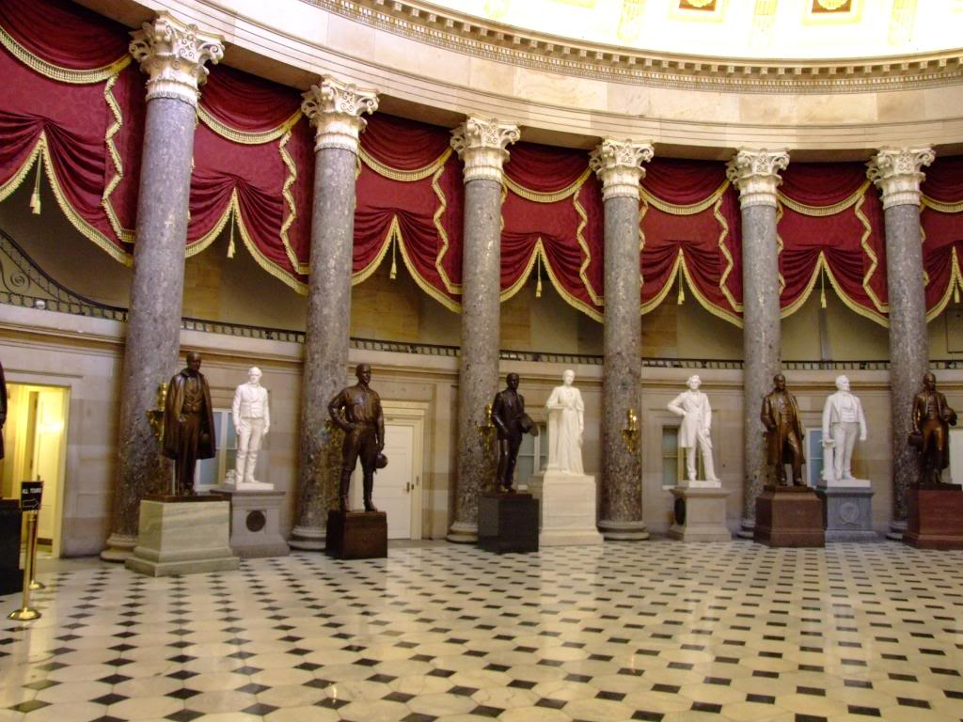
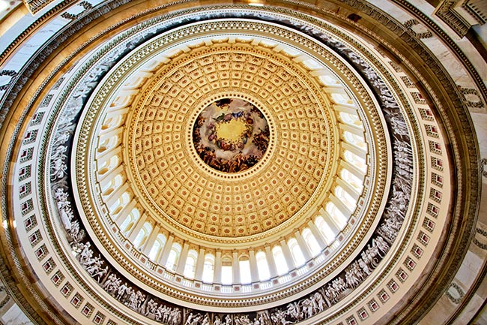

Slide 29
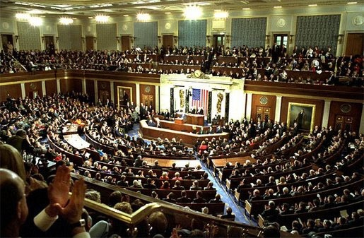

Slide 30
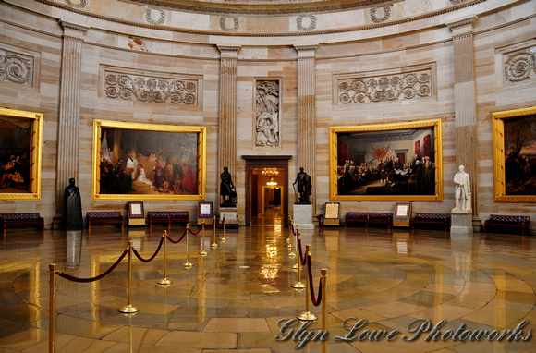

Slide 31
US-democratic republic-citizens elect representatives to make decisions for us

Slide 32
3 Branches of U.S.Government
Executive Branch:
Makes sure the laws are carried out
Headed by the President
Appoints a cabinet-group of advisors
Can veto laws
4 year term
Elected only 2 times

Slide 33
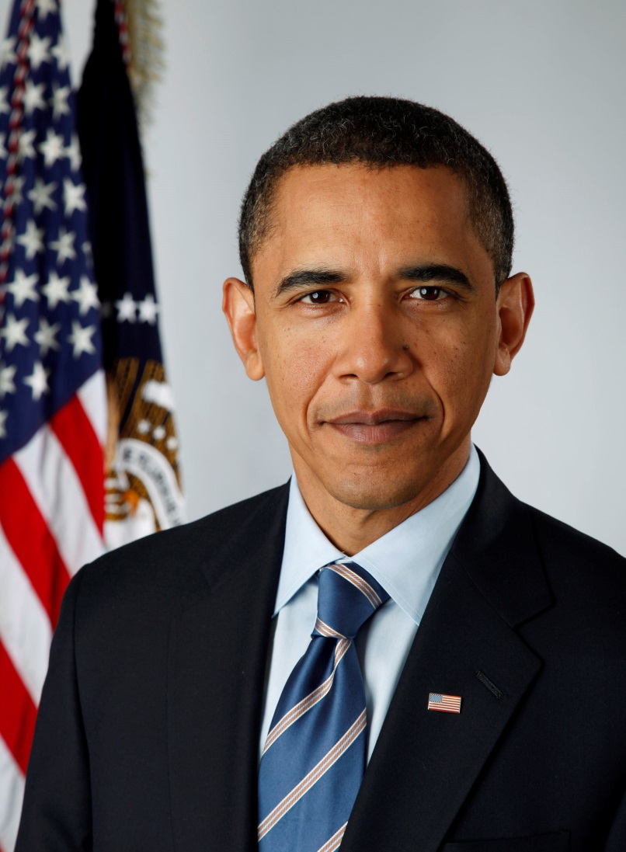
President-Barack Obama

Slide 34
Legislative Branch
House of Representatives
Decided by the state population
Senate
2 from each state
Pass laws
Approve treaties

Slide 35
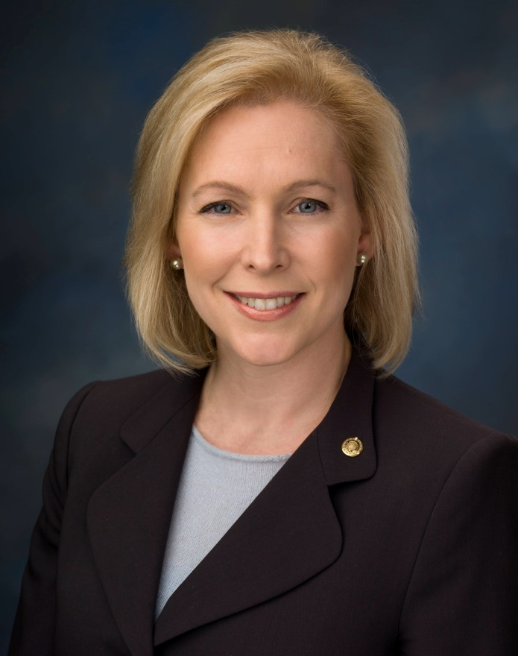
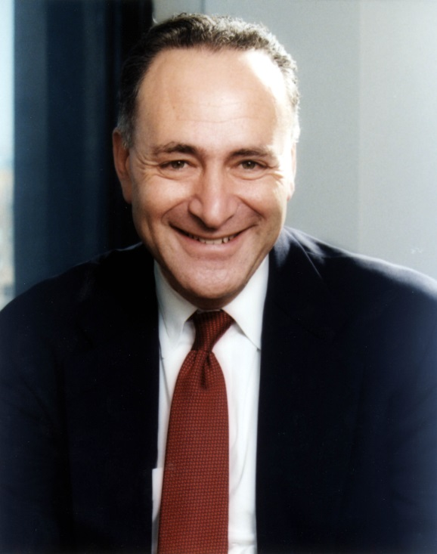
Senator Chuck Schumer Kristen Gillibrand

Slide 36
Judicial Branch
Supreme Court-highest federal court
Interpret laws
Supreme Court judges chosen by the President
Serve for life

