Slide 1
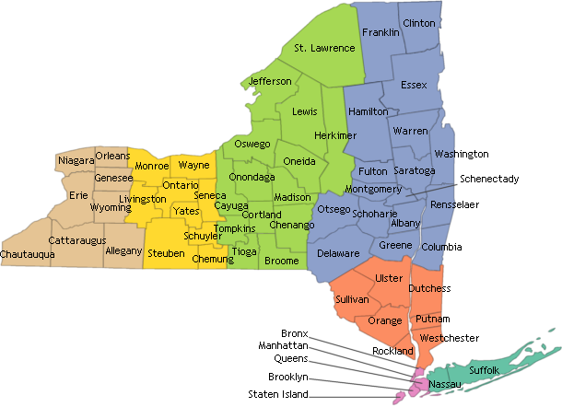
Chapter 1 The Land of NY

Slide 2
Where is New York?
Geography- the study of Earth and of the ways people, plants, and animals use it
NY’s global address-the United States, North America
NY’s land
Landform-part of geography: a natural feature on Earth’s surface

Slide 3
The Ice Age
Ice Age-a period of time when ice covered Northern US
Occurred about 20,000 yrs ago
Glaciers-giant sheets of ice that covered most of Northern US including all of NY
2. Glaciers shaped many landforms found in NY
a. Great Lakes and Finger Lakes were formed when ice melted
b. moraine-a line of low hills formed when rocks pushed at the front of a glacier

Slide 4
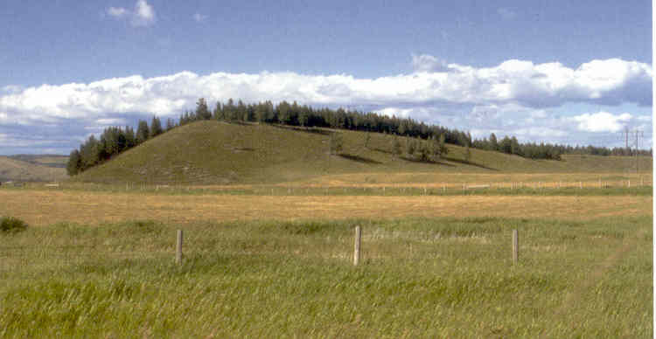
c. About 10,000 yrs ago, Earth’s climate changed
i. glaciers melted and their water filled trenches and made lakes and rivers
ii. Also left behind till-soil and rock which is rich soil
iii. Drumlin-smoothly rounded hills were also left when glaciers melted

Slide 5
6 Areas or Regions of NY
region-an area with common features such as landforms, rivers, or natural resources-something found in nature
-different resources can create different kinds of jobs
Ex. If an area has good soil you have farming jobs; of if you are near a forest, you have jobs like forestry.

Slide 6
NY’s Waterways
Important uses of water
In past and today, people use waterways to move goods from place to place
Goods-products
For trade
For transportation
For irrigation

Slide 7
NY’s Rivers
a. Parts of a river
i. source-the place where a river begins
ii. Mouth-end of a river where it empties into an ocean or river
iii. Tributary- smaller river
b. Hudson River-NY’s longest and largest river named for explorer Henry Hudson
c. St. Lawrence River- separates NY from Canada
i. Thousand Islands found at the mouth
d. Niagara River-begins at Lake Erie and flows into Lake Ontario

Slide 8
New York’s Lakes
Border-a line that people agree on that divides 1 place from another
Boundary- another word for border
a. Lake Champlain-located in the northern part of NY: forms part of the border or boundary between NY and Vermont
b. Finger Lakes-finger shaped lakes found in the center of NY

Slide 9
c. Great Lakes-5 large lakes
i. found in the northern part of the US
Huron
Ontario
Michigan
Erie
Superior
iii. Lake Erie and Lake Ontario form part of NY’s border with the countries of Canada: Major transportation route to major cities.

Slide 10
New York and the Ocean
The mouth of the Hudson River opens into NY
Harbor-a sheltered body of water along a coast
b. Is one of the finest natural harbors in the world
c. NY borders the Atlantic Ocean in the southeast corner of the state
d. coast-the land along an ocean

Slide 11
NY’s Seasons
Climate and Weather
Weather-the condition of air at a certain time and in a certain place
Climate-weather in a certain place over many years
Temperature- how hot or cold the air is
Elevation- height above sea level
Sea level-the height of land where it meets the sea
Precipitation- the amt. of moisture that falls as rain, snow, sleet, or hail

Slide 12
Precipitation affects weather and climate
Location affects temperature of an area and how much precipitation are will get
*Higher elevation-colder temps.
*wind blowing over water in summer-rain
*in winter, wind blowing over Great Lakes-snow
Extreme weather: strong winds, heavy precipitation, blizzards

Slide 13
Resources of NY
Types of Resources
Natural resources- things that come from the environment
Environment-surroundings in which plants, people, and animals live
Renewable resources-resources that can be replaced
Ex. Trees, bottles, glass
b. Nonrenewable resources- resources that cannot be replaced.
Ex. Minerals, iron, fossil fuels

Slide 14
Conservation- the careful use of natural resources
Ex. Recycling or reusing materials; not wasting cans or paper, keeping water and the environment clean
c. People make resources or raw material
Useful products; ex: iron can be made into steel
-products also called goods
d. Many jobs in a region depend on its resources
Ex. Northern NY
Trees lumbering wood products
e. people’s jobs involve either getting or growing resources, making goods or providing services
f. Capital resources- money, buildings, machinery necessary to create goods or provide services

